Slide 1
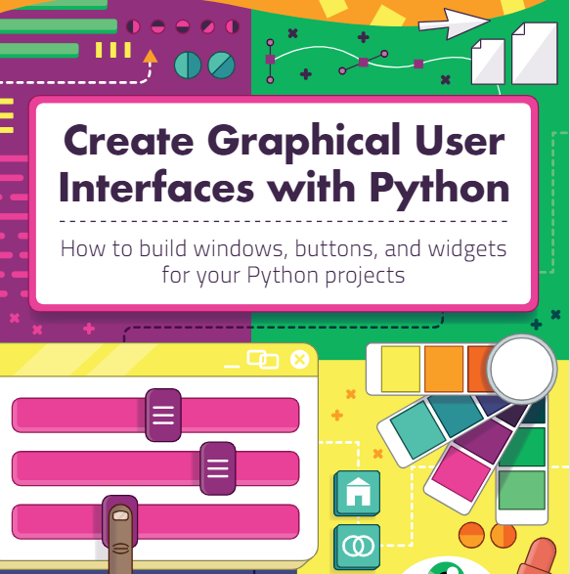
GUI in Python : guizero
Building Graphical User Interfaces in Python
LAJ updated 4/5/23
https://lawsie.github.io/guizero/
You can download the pdf of this printed book from here:
https://magpi.raspberrypi.com/books/create-guis

Slide 2
Hello World
from guizero import App
app = App(title="Hello world")
app.display()

Slide 3

Adding Text
from guizero import App, Text
app = App(title="Hello world")
message = Text(app, text="Welcome to the Hello world app!")
app.display()

Slide 4
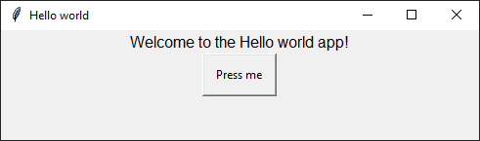
Add a button – that runs a function
from guizero import App, Text, PushButton
def change_message():
message.value = "You pressed the button!"
app = App(title="Hello world")
message = Text(app, text="Welcome to the Hello world app!")
button = PushButton(app, text="Press me", command=change_message)
app.display()

Slide 5
Add a text box
from guizero import App, Text, TextBox, PushButton
def do_something():
if tbox.value=="Bob":
message.value = "Welcome Bob"
else:
message.value = "You're not Bob!"
app = App(title="Hello world")
message = Text(app, text="Enter your name!")
tbox = TextBox(app)
button = PushButton(app, text="Press me", command=do_something)
app.display()

Slide 6
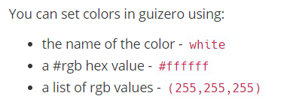
Colours
app.bg = "red"
tbox.bg = "white"

Slide 7
Add a Picture
from guizero import App, Picture
app = App()
pic = Picture(app, image="myimage.gif")
app.display()

Slide 8
Task1: Create a number guessing game
Guizero practice task
Generate a random number 1 to 10
User types their guess into a text box
Clicks a button to check their guess (think about data type)
If the guess is wrong, display message “wrong” and add one to a count
Extra – compare with original number to say if too low/high
If the guess is correct, display message “correct” and how many guesses
Extension: Text should be red for wrong and green for correct
Extension 2: Show an picture for wrong and right

Slide 9
A meme generator – with a Drawing Widget
a Drawing widget which will hold the image and text.
from guizero import App, TextBox, Drawing
def draw_meme():
meme.clear()
meme.image(0, 0, "woodpecker.png")
meme.text(20, 20, top_text.value)
meme.text(20, 320, bottom_text.value)
app = App("meme")
top_text = TextBox(app, "top text")
bottom_text = TextBox(app, "bottom text")
meme = Drawing(app, width="fill", height="fill")
draw_meme()
app.display()

Slide 10
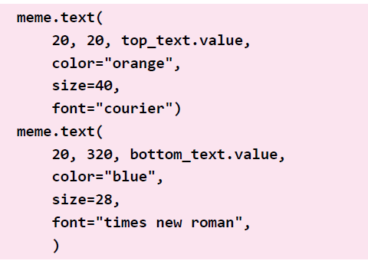
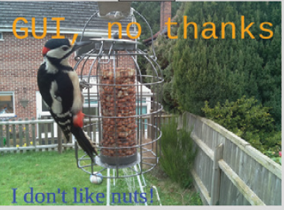
Styling text boxes
This is a Drawing widget

Slide 11
Toggle 2 buttons
Have 2 buttons, start and stop with them changing the enabled state of each other.
from guizero import App, PushButton
def start():
start_button.disable()
stop_button.enable()
def stop():
start_button.enable()
stop_button.disable()
app = App()
start_button = PushButton(app, command=start, text="start")
stop_button = PushButton(app, command=stop, text="stop", enabled=False)
app.display()

Slide 12
Examples
Really really simple example: https://replit.com/@laurajamesBCS/playing-with-gui#main.py
Really simple card game: https://replit.com/@laurajamesBCS/GuiZero-Card-Game#main.py
Using Guizero as an interface for a SQL database
https://replit.com/@laurajamesBCS/SQL-and-Guizero#main.py

