Slide 1

PHP Programming
Using Cloud 9 IDE
alas Cloud 9 is no longer available
other options are local development using XAMPP or hosting (ask Mrs James!)

Slide 2
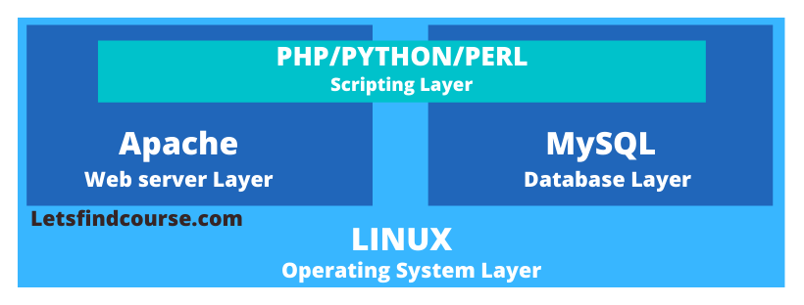
Web development
LAMP stack
Linux
Apache
MySQL
PHP

Slide 3
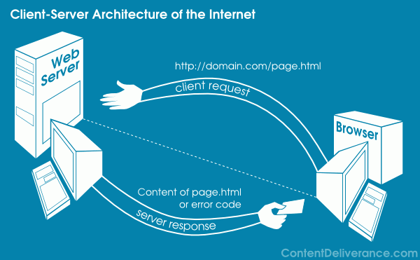
Client Server Architecture

Slide 4
PHP
Server based scripting
Open source
Used in many websites
Can be used within HTML code in pages
Syntax:
Case sensitive
Semi colons at end of lines
Curly brackets enclose blocks
Variables start with $ - eg $myname
Php embedded into HTML using <?php …?> tags

Slide 5
IDE (integrated development environment)
Can use a text editor or Dreamweaver
Php files must run on a server to get PHP to work
Can buy your own hosting
Or set up a “Localhost” to run locally (or off a USB stick)
We use cloud 9 a free hosting service with an inbuilt IDE
Mrs James can invite you to a free teamaccount

Slide 6
Syntax rules
Similar to Javascript:
Semicolons at the end of lines
Blocks of code are contained in {}
Case sensitive
Comments are /* */
Unique to PHP
Php is embedded within the HTML using the following tags
<?php ………?>
Variables are declared with $ before their names
Eg $yourname, $score, $username
Concatentate text with a . (not a + sign)
Output information to the web page using the function echo
echo “hello world”

Slide 7
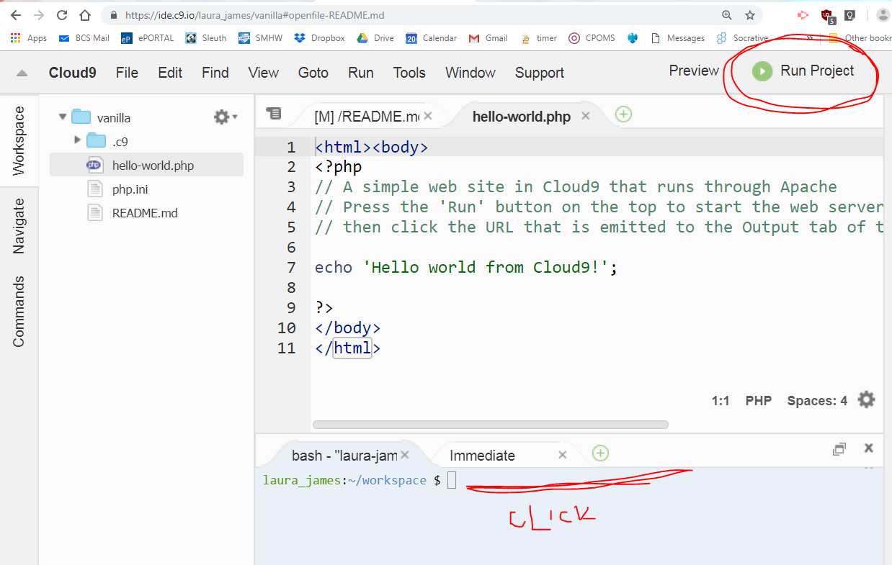
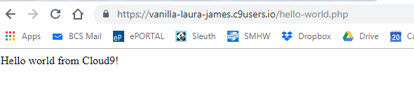
Php function echo will print data to the web page.
Note: It is embedded within HTML tags

Slide 8
Reasons to use PHP
Even for static sites that don’t require a backend database PHP can be useful as it allows you to share (or include) files
This means you can use the same header or footer across multiple pages
Or you can store commonly used functions in one place and refer to them across all pages

Slide 9
Structuring your PHP project
Good developing practice to separate your code into logical groups using folders
- included files
- images
- css
- javascript
So it’s a good idea to create these folders now

Slide 10
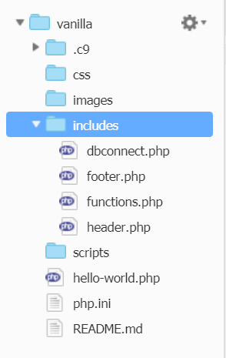
Includes folder
Create the following blank php files in your includes folder
Header.php to hold all the code you want to appear at the top of every page
Footer.php to hold the code to appear at the bottom of every page
Functions.php which will hold all commonly used functions
DBConnect.php which will hold the connection to the MySQL database

Slide 11
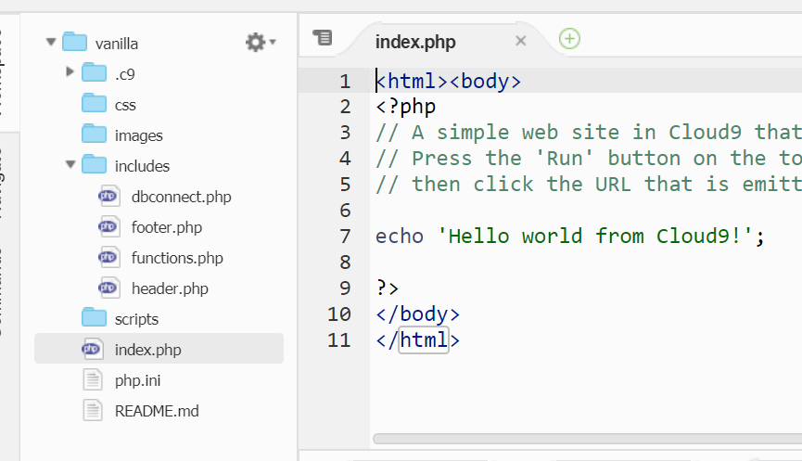
The HomePage – index.php
All websites should have a homepage – if not the website may direct you to a list of directories – could be a security risk
Usually they are called index.html or index.php
Rename the hello-world.php to index.php and try opening your project again

Slide 12
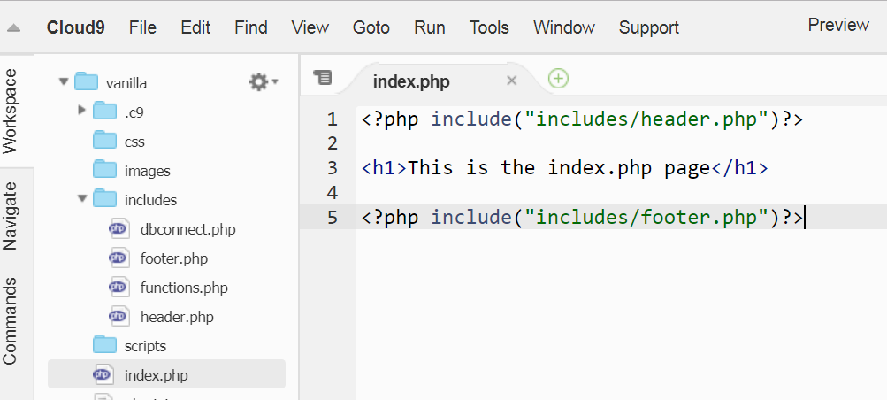
Including files
Use the include function to insert other php files into your web page

Slide 13
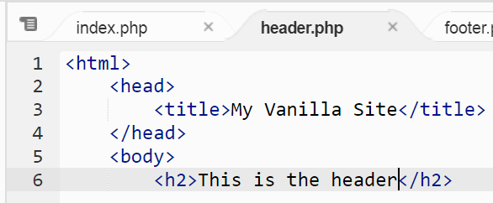
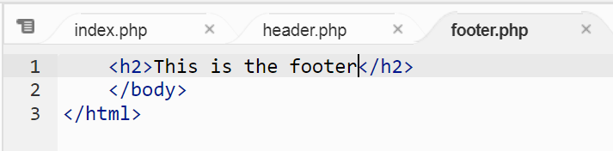
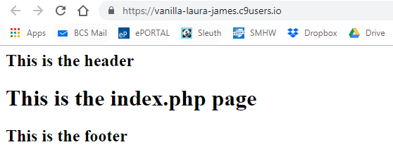
Header & Footer start
Notice how the <html> tags and the body tags are split across the two included files

Slide 14
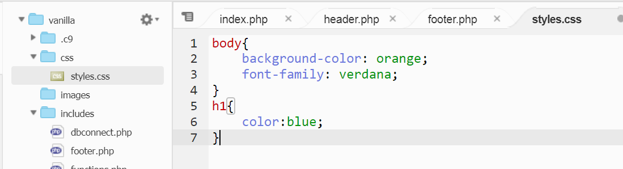
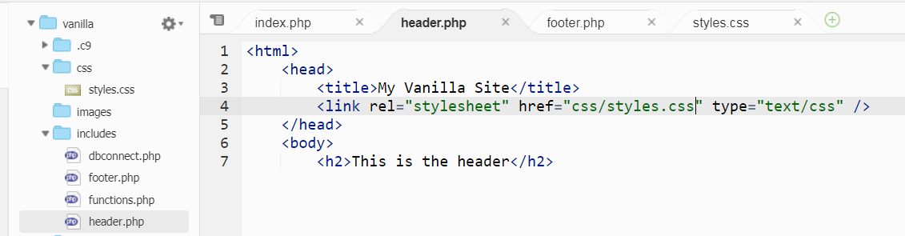
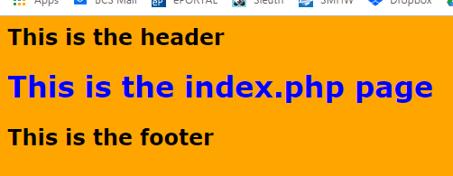
Add a stylesheet
CSS allows you to do MUCH more with web pages – however it shouldn’t be the main focus of your project as its more style than algorithms!

Slide 15
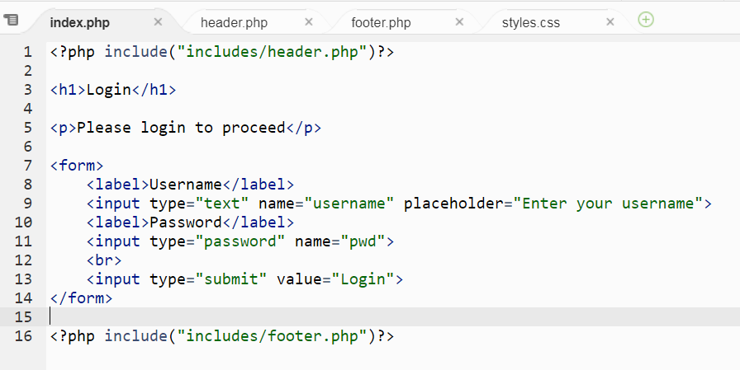
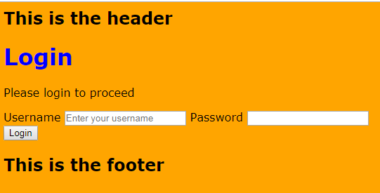
Adding some input fields
Nothing happens at the moment but you can see that there are 2 fields and a button
Notes:
<?php include("includes/header.php")?><h1>Login</h1><p>Please login to proceed</p><form> <label>Username</label> <input type="text" name="username" placeholder="Enter your username"> <label>Password</label> <input type="password" name="pwd"> <br> <input type="submit" value="Login"></form><?php include("includes/footer.php")?>

Slide 16
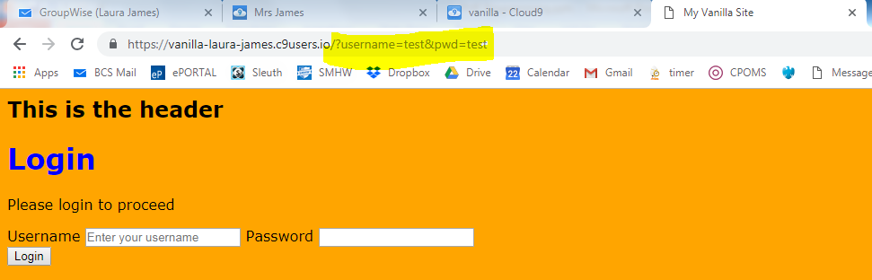
The <form> tag
This marks out a portion of the web page to be acted upon.
It can have several attributes
Method = post or get (get can be a security risk as the values can be seen in the url)
Action = the web page it should go to
If blank the form will submit the data to the same page

Slide 17
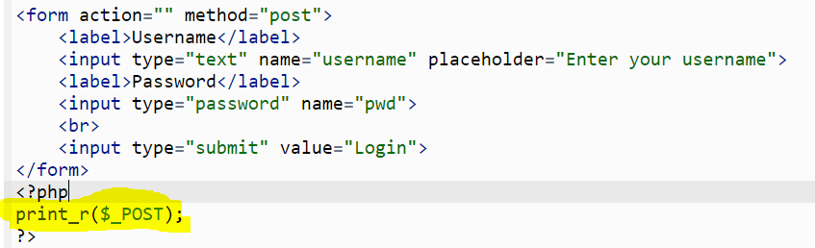
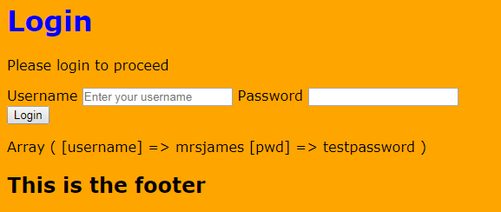
Accessing the information typed in in a form
Use the $_POST[] array to see what variables have been submitted
So we can get what they typed in the Username field by using
$_POST[“username”]

Slide 18
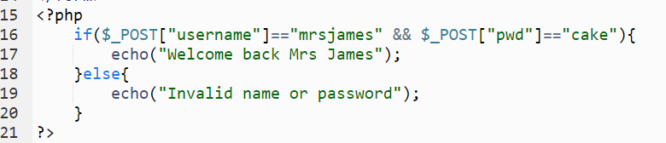
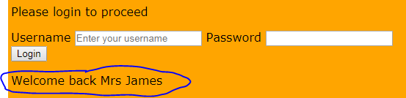
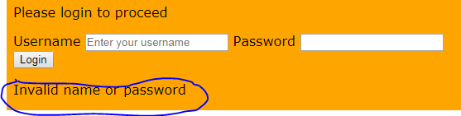
Simple authentication script
Tests if the username & the password match given values and prints out a message

Slide 19
Issues with this code
Invalid name or password appears for the first time even before the user has tried to login
On correct login it should redirect to a different page
Should there be different messages of the name and/or password are blank (validation)?
The name & password are hardcoded – what happens if we want to add more valid logins
Need to use a database! (more later)

Slide 20
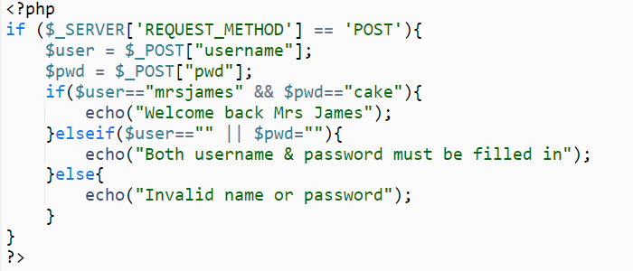
Improvement 1
Extra checks for the name & password
This if statement checks if the form has been submitted and stops the error msg appearing the 1st time you go to the page

Slide 21
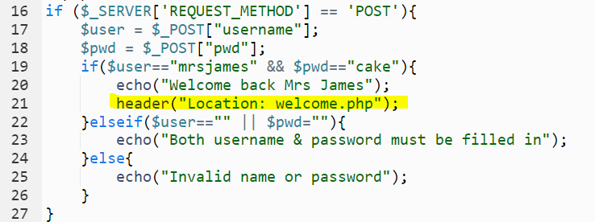
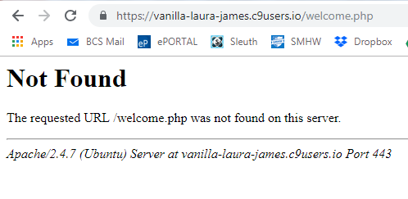
Redirecting to a new page
You will now need to create a welcome.php page of course (just copy index.php and then change the text inside)
In practice any PHP that uses this redirect should be done BEFORE any HTML has been output to the screen (but this seems to work for now)

Slide 22
MySQL
MySQL
Database
MySQL is the database system we will use to store any website information we need
Eg
User details for login
Data that will be added from the website (eg sports results, reminders)
Visitor information for tracking
Notes:
# start MySQL.
Will create an empty database on first start
$ mysql-ctl start
# stop MySQL
$ mysql-ctl stop
# run the MySQL interactive shell
$ mysql-ctl cli

Slide 23
PhpMyadmin
Phpmyadmin is an easy to use PHP based Database Management System allowing you to create, edit and manage MySQL databases
First, create a PHP workspace so you have PHP, MySQL, and Apache installed right away.
You can then make sure you have MySQL installed by running:
mysql-ctl install
Then install phpMyAdmin:
phpmyadmin-ctl install
After the installation is complete you'll just want to make sure mysql is running once more:
mysql-ctl start

Slide 24
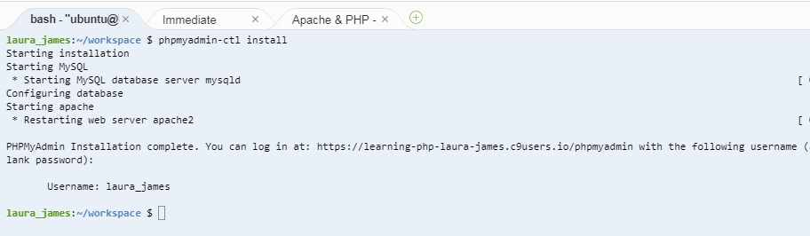
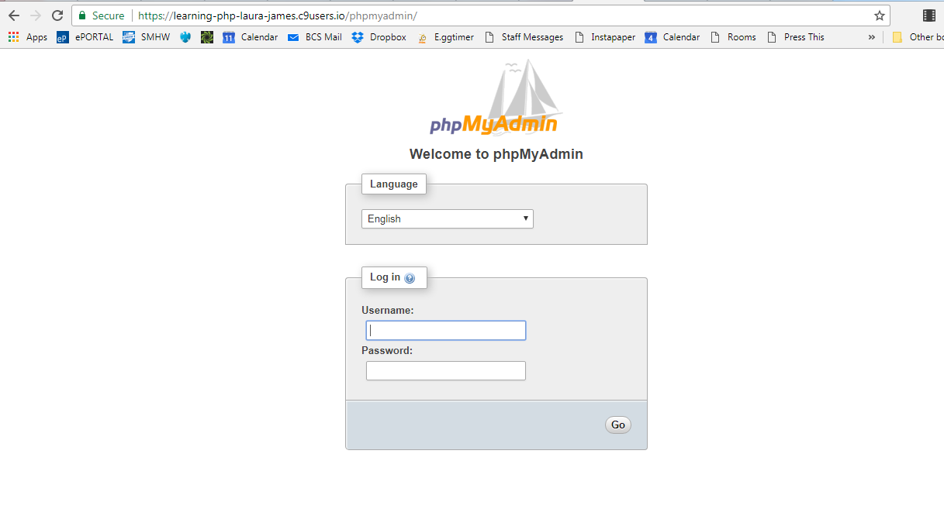
No password by default!
Security risk!

Slide 25
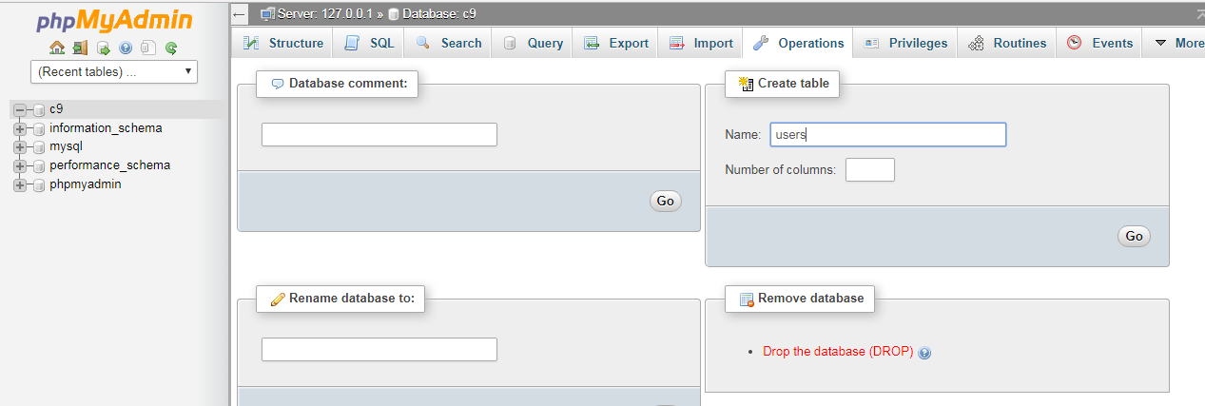
Create a database called users with 3 columns
Notes:
<?php // A simple PHP script demonstrating how to connect to MySQL. // Press the 'Run' button on the top to start the web server, // then click the URL that is emitted to the Output tab of the console.
$servername = getenv('IP');
$username = getenv('C9_USER');
$password = "";
$database = "c9";
$dbport = 3306;
// Create connection
$db = new mysqli($servername, $username, $password, $database, $dbport);
// Check connection
if ($db->connect_error) {
die("Connection failed: " . $db->connect_error);
} e
cho "Connected successfully (".$db->host_info.")";

Slide 26
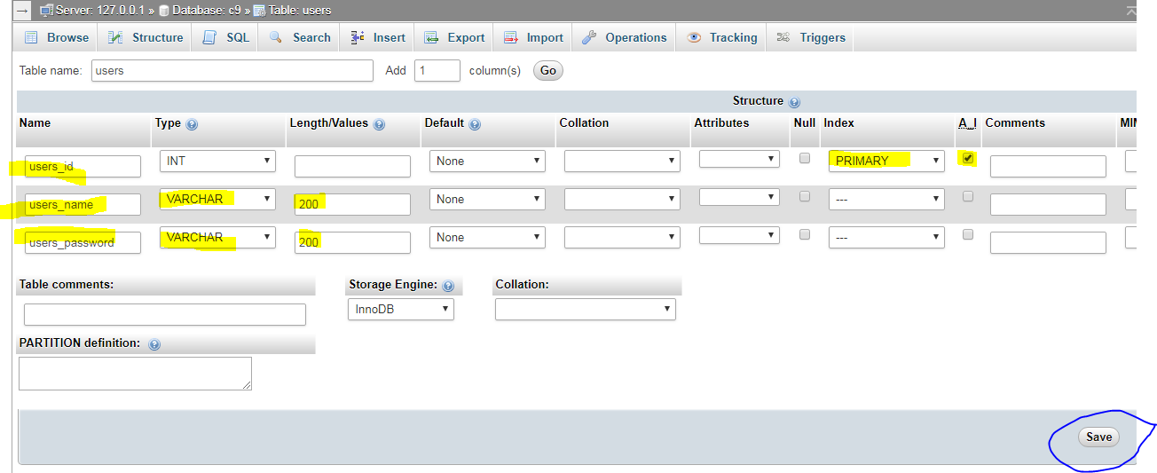
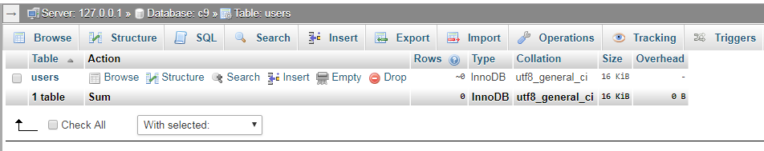
Created – you can see the new table users in the list

Slide 27
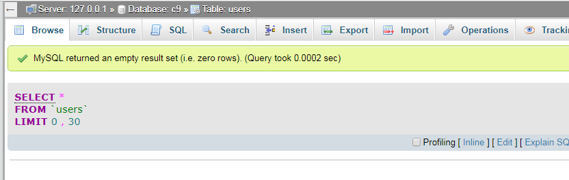
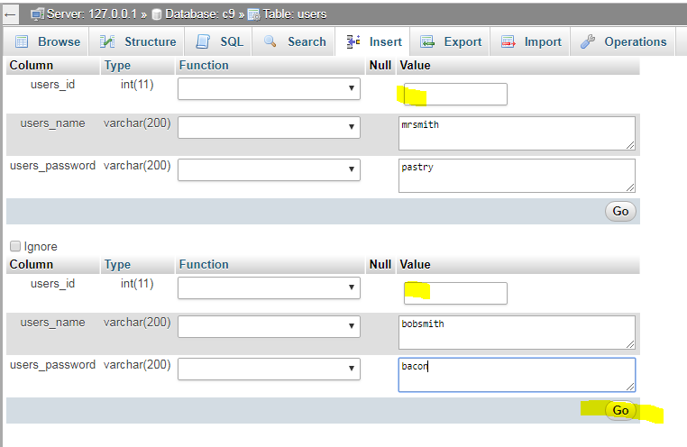
This will manually add two users to the database
(Don’t fill in the ID as MySQL will add that automatically)

Slide 28
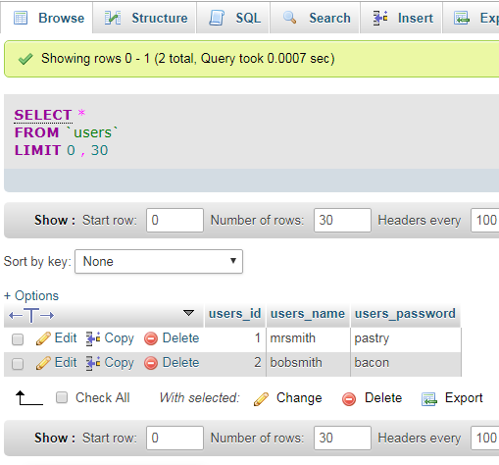
See how the primary key ( the users_id field) is automatically added and incremented each time

Slide 29
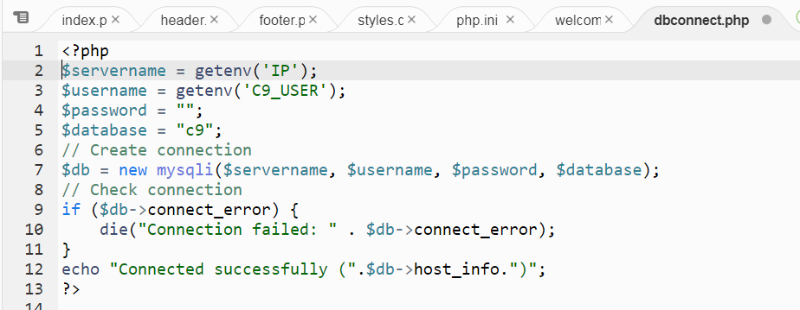
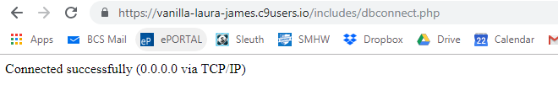
Check you can connect to the database
Add this code to your dbconnect.php file
Test it by going directly to the dbconnect.php in the address bar – you should see this…
Notes:
<?php
$servername = getenv('IP');
$username = getenv('C9_USER');
$password = "";
$database = "c9";
// Create connection
$db = new mysqli($servername, $username, $password, $database);
// Check connection
if ($db->connect_error) {
die("Connection failed: " . $db->connect_error);
}
echo "Connected successfully (".$db->host_info.")"; ?>

Slide 30
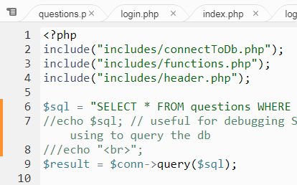
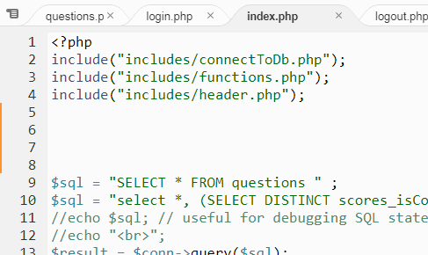
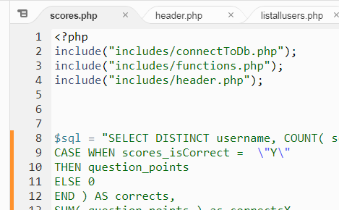
Using the dbconnect.php file in all pages
Database credentials and the connection string should be just stored in one place
If you store them in multiple places there will be an issue in finding them all if you need to update a password
We now need to include this file in all our pages (as most pages will need to connect to the database in some way)

Slide 31
Getting Data Out of a database
Use and SQL statement such as
SELECT * from questions
Or
SELECT * from users WHERE userid=“mrsjames”
Work out what the SQL statement you want to run is first, then test it in phpmyadmin
You can then copy it to your php code and substitute in the variables

Slide 32
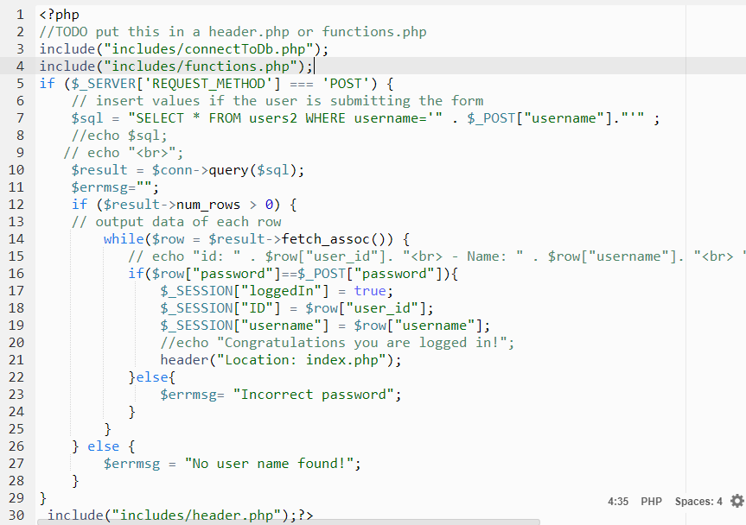
Using the mySQLi object in PHP
Runs the SQL query and puts values in a variable called $result
If there are some records returned…
Loops through each record checking the password matches
Notes:
<?php $sql ="SELECT * from users WHERE username ='".$_POST["username"]."'";echo $sql;$result = $db->query($sql);if($result->num_rows > 0){ //echo "something found"; while ($row = $result->fetch_assoc()){ echo $row["username"]." - ".$row["password"]; }}if($_SERVER['REQUEST_METHOD']=="POST"){ if($_POST["username"]=="laura" && $_POST["pwd"]=="cake" ){ //echo "<h2>Welcome back Mrs James</h2>"; header("Location:page1.php"); }else{ echo "<h2>incorrect name & password</h2>"; }}?><h1>Login</h1><p>Please login to proceed</p><form action="" method="POST"> <label>Username</label> <input type="text" name="username" placeholder="Enter your username"> <br> <label>Password</label> <input type="password" name="pwd"> <br> <input type="submit" value="Login"></form><?php include("footer.php")?>

