Slide 1
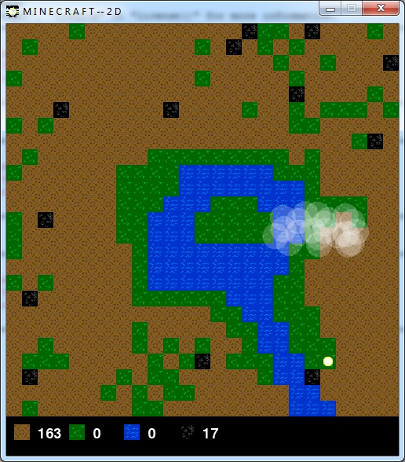

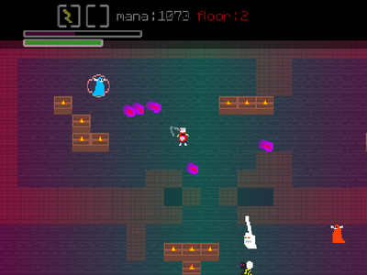
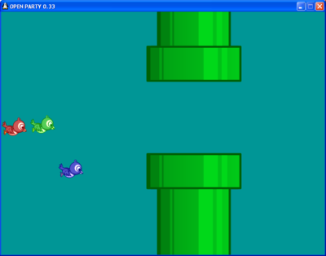
Pygame Introduction

Slide 2
What is Pygame?
PYTHON 2 not 3!
Pygame is a cross-platform set of Python modules designed for writing video games.
It includes computer graphics and sound libraries designed to be used with the Python programming language.

Slide 3

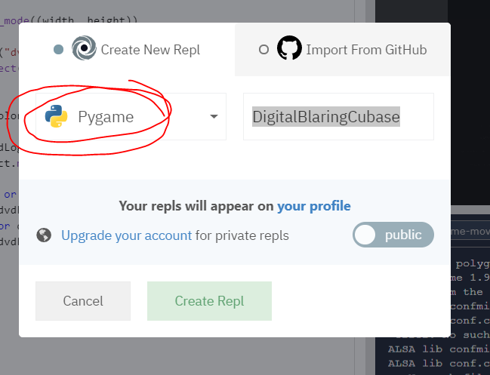
First steps
Import the library
Initialise Pygame
Pygame on repl.it doesn’t always work well though…

Slide 4
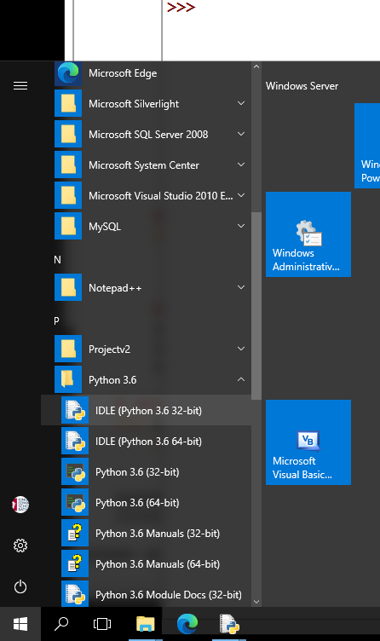
Connect to the Dev Server
Scroll to Python 3.6
Choose IDLE 32bit version
Other versions won’t work!
In IDLE do File > New File
Type in code below
Run with F5
Save it but NOT as pygame.py
Should get a pop up window!

Slide 5
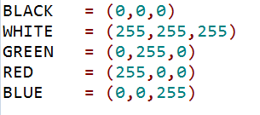
Set up some colour variables
Made up of a tuples
3 numbers
Amount of Red,Green,Blue

Slide 6
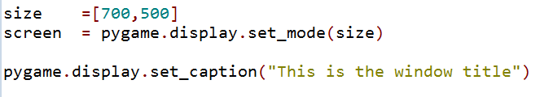
Set up Pygame window
Set the size (with and height)
Set the window title

Slide 7

Add a clock
This will add the timer to allow our gamescreen to be drawn every few milliseconds

Slide 8
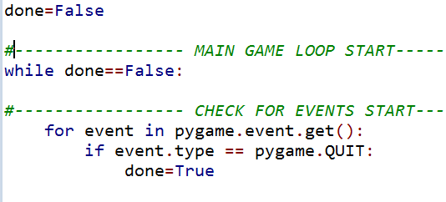
Checking for a QUIT event
The game “loop” will run until a user closes window
This is a QUIT event
And it changes the done variable from False to True
All drawing happens in game loop

Slide 9
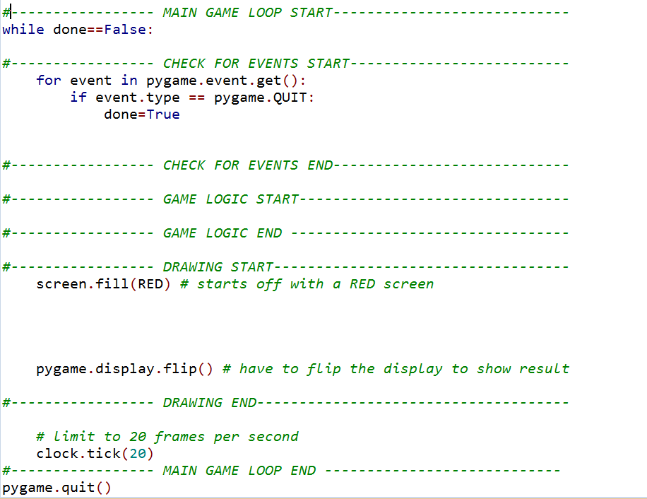
Events
Game Logic
Drawing
how often screen refreshes

Slide 10
Task:
Copy starter python replit
https://repl.it/@laurajamesBCS/PyGame-Start
Try and run it
Change the window title and the background colour
Run it again
If Repl.it isn’t working then the starter code can be copied from the Notes on this slide VVVVV
Notes:
"""
Use this pygame starter template to begin your game
http://youtu.be/vRB_983kUMc
"""
import pygame
pygame.init()
BLACK = (0,0,0)
WHITE = (255,255,255)
GREEN = (0,255,0)
RED = (255,0,0)
BLUE = (0,0,255)
size =[700,500]
screen = pygame.display.set_mode(size)
pygame.display.set_caption("This is the window title!!!")
clock=pygame.time.Clock()
done=False
#----------------- MAIN GAME LOOP START----------------------------
while done==False:
#----------------- CHECK FOR EVENTS START--------------------------
for event in pygame.event.get():
if event.type == pygame.QUIT:
done=True
#----------------- CHECK FOR EVENTS END----------------------------
#----------------- GAME LOGIC START--------------------------------
#----------------- GAME LOGIC END ---------------------------------
#----------------- DRAWING START-----------------------------------
screen.fill(RED) # starts off with a RED screen
pygame.display.flip() # have to flip the display to show result
#----------------- DRAWING END-------------------------------------
# limit to 20 frames per second
clock.tick(20)
#----------------- MAIN GAME LOOP END ----------------------------
pygame.quit()

Slide 11
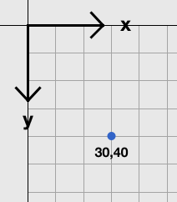
Drawing lines
Put this in the game loop
pygame.draw.line(screen, GREEN, [0,0],[100,100],12)
screen to draw it on
Colour
Starting co-ordinate
End co-ordinate
Width of line

Slide 12
Task:
Add a line to you pygame code
Make sure you add it in the drawing section
Inside the while loop
But outside the for loop
Run it
Add more lines to draw a zig zag
Advanced:
Can you draw repeating lines using a for loop?

Slide 13
Adding rectangles and ellipses
Put this in the game loop
pygame.draw.line(screen, GREEN, [0,0],[100,100],12)
pygame.draw.rect(screen,BLACK,[20,20, 250,100],2)
screen to draw it on
Colour
Starting co-ordinates x and y
width
height
line thickness (or leave blank for filled rectangle)
pygame.draw.ellipse(screen,BLACK,[20,20, 250,100],2)
will draw an ellipse inside the containing rectangle

Slide 14
Task:
Add a rectangle to you pygame code
Make sure you add it in the drawing section
Run it
Add more rectangles
Use the code to draw an ellipse
Advanced:
Can you draw repeating rect/ellipses using a for loop?

Slide 15
Adding images (save png to same folder)
player_img= pygame.image.load('squirrel.png').convert()
loads image into variable
Only need to convert png files
screen.blit(player_img,(100,100))
name of your image variable
x,y coordinates where to add it to your screen
Adds it to your screen
For cropped images see later slide

Slide 16
Task
Find an image (png) and save it to the same folder as your Python file
Add it to your screen
Find additional images and add them
Can you add the same image multiple times?

Slide 17

Animating your image
This code will add 1 to the x coordinate of your image
Because this is inside the drawing loop the image will look like its gradually moving across the screen
Note: you will need to add playerx=0 at the top of your code

Slide 18
Task
Add the code that will make your image move across the screen
How can you make it go faster?
How can you stop it from going across the screen?
How can you make it change direction?

Slide 19
Resources
Pygame resources
https://www.pygame.org/docs/
http://www.nerdparadise.com/programming/pygame/part1
http://programarcadegames.com/index.php?lang=en&chapter=array_backed_grids

Slide 20
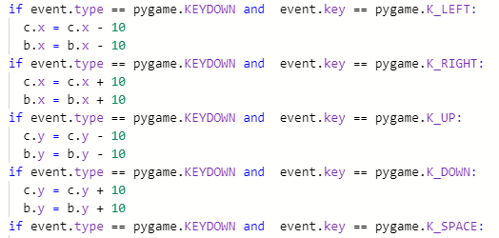
Interactivity
if event.type == pygame.KEYDOWN and event.key == pygame.K_SPACE:
This can be added to your events block to detect if a space bar has been pressed.
You can then extend it to move a player on WASD or arrow keys
Notes:
"""
Use this pygame starter template to begin your game
http://youtu.be/vRB_983kUMc
"""
import pygame
pygame.init()
BLACK = (0,0,0)
WHITE = (255,255,255)
GREEN = (0,255,0)
RED = (255,0,0)
BLUE = (0,0,255)
size =[700,500]
screen = pygame.display.set_mode(size)
playerx=0
pygame.display.set_caption("This is the window title!!!")
clock=pygame.time.Clock()
done=False
#----------------- MAIN GAME LOOP START----------------------------
while done==False:
#----------------- CHECK FOR EVENTS START--------------------------
for event in pygame.event.get():
if event.type == pygame.QUIT:
done=True
if event.type == pygame.KEYDOWN and event.key == pygame.K_SPACE:
playerx = 0
#----------------- CHECK FOR EVENTS END----------------------------
#----------------- GAME LOGIC START--------------------------------
#----------------- GAME LOGIC END ---------------------------------
#----------------- DRAWING START-----------------------------------
screen.fill(RED) # starts off with a RED screen
pygame.draw.line(screen, GREEN, [0,0],[100,100],12)
player_img= pygame.image.load('squirrel.png').convert()
playerx = playerx+5
playery=100
screen.blit(player_img,(playerx,playery))
pygame.display.flip() # have to flip the display to show result
#----------------- DRAWING END-------------------------------------
# limit to 20 frames per second
clock.tick(50)
#----------------- MAIN GAME LOOP END ----------------------------
pygame.quit()

Slide 21
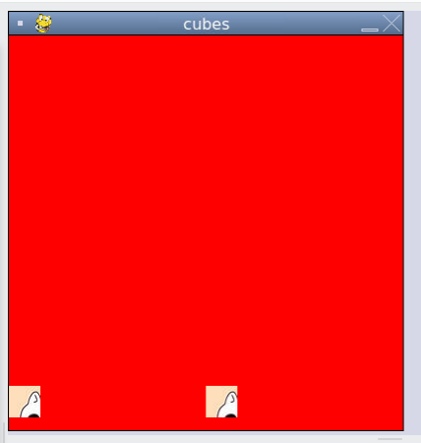

Cropping an image
Use an intermediary image to “blit” your loaded image – then “Blit” this to the screen
Could be useful to get images from a spritesheet?

Slide 22
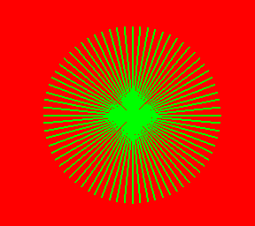
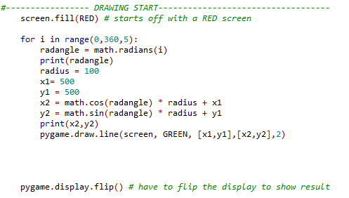
Example: Drawing an orbit
Use some trigonometry!
Notes:
"""
Use this pygame starter template to begin your game
http://youtu.be/vRB_983kUMc
"""
import pygame
import math
pygame.init()
BLACK = (0,0,0)
WHITE = (255,255,255)
GREEN = (0,255,0)
RED = (255,0,0)
BLUE = (0,0,255)
size =[1000,800]
screen = pygame.display.set_mode(size)
pygame.display.set_caption("This is the window title!!!")
clock=pygame.time.Clock()
done=False
#----------------- MAIN GAME LOOP START----------------------------
while done==False:
#----------------- CHECK FOR EVENTS START--------------------------
for event in pygame.event.get():
if event.type == pygame.QUIT:
done=True
#----------------- CHECK FOR EVENTS END----------------------------
#----------------- GAME LOGIC START--------------------------------
#----------------- GAME LOGIC END ---------------------------------
#----------------- DRAWING START-----------------------------------
screen.fill(RED) # starts off with a RED screen
for i in range(0,360,5):
radangle = math.radians(i)
print(radangle)
radius = 100
x1= 500
y1 = 500
x2 = math.cos(radangle) * radius + x1
y2 = math.sin(radangle) * radius + y1
print(x2,y2)
pygame.draw.line(screen, GREEN, [x1,y1],[x2,y2],2)
pygame.display.flip() # have to flip the display to show result
#----------------- DRAWING END-------------------------------------
# limit to 20 frames per second
clock.tick(2)
#----------------- MAIN GAME LOOP END ----------------------------
pygame.quit()

Slide 23
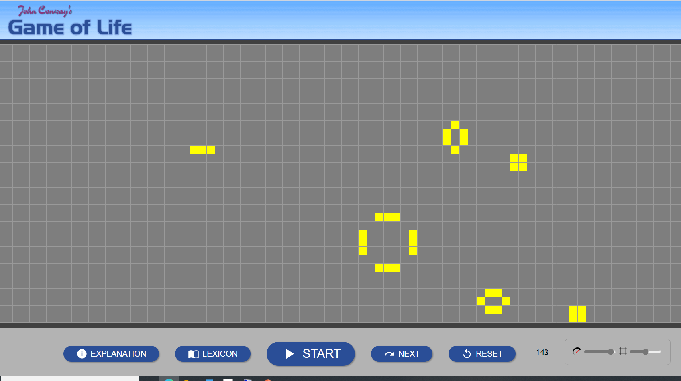
Y12 Project Ideas with Pygame
Conways Game of Life Simulation
https://playgameoflife.com/

Slide 24
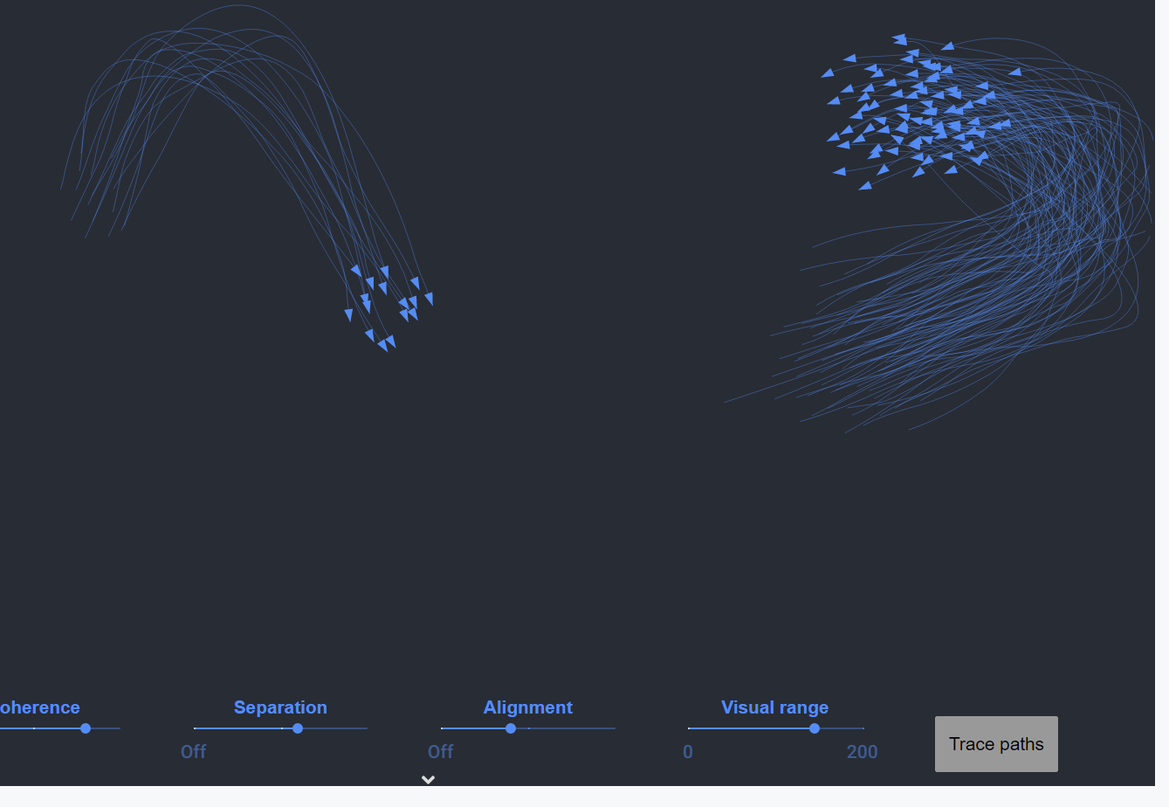
Y12 Project Ideas with Pygame
Simulating Flocking
https://eater.net/boids

Slide 25
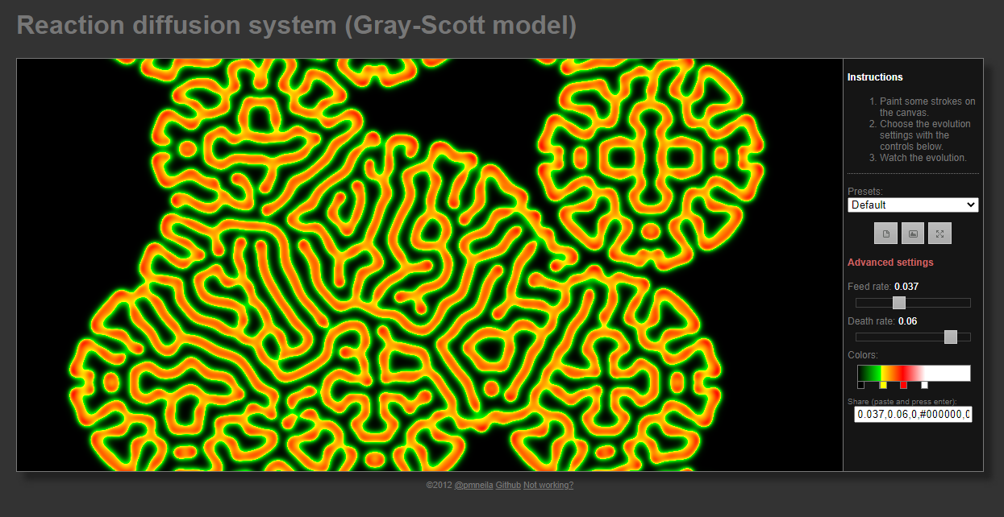
Y12 Project Ideas with Pygame
Simulating the reaction- diffusion Pattern generator
http://pmneila.github.io/jsexp/grayscott/
https://itp.uni-frankfurt.de/~gros/StudentProjects/Projects_2020/projekt_lichuan_zheng/

