Slide 1
Python Code To Know
GCSE and A Level
Work In Progress – LAJ 25th May 2023

Slide 2
GSCE Computer Science
Link to Python Notebook

Slide 3
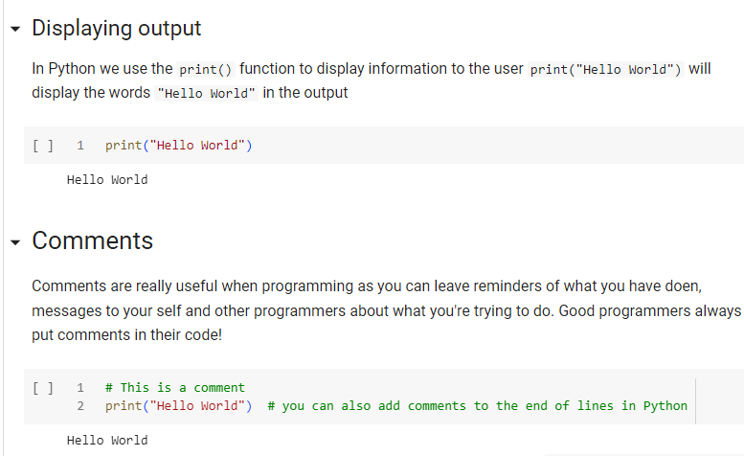

Print & Input
Input() takes input from the user
You can assign a variable using this input
Note: it will always be a string so use a function like int() or float() to convert it if you want to do arithmetic with it

Slide 4
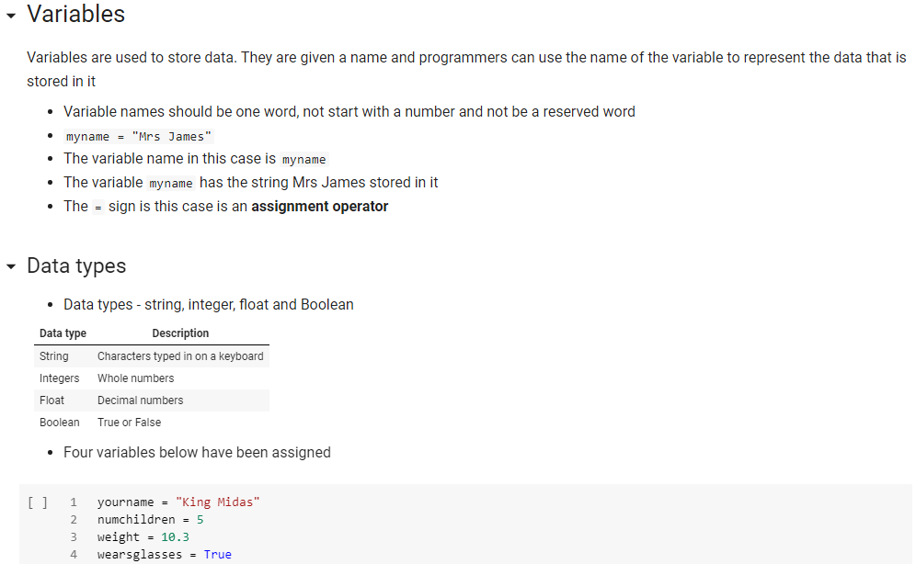
Variables and data types
Character is also a data type in the exam but it's not a valid data type in Python! It is basically a single letter/character

Slide 5
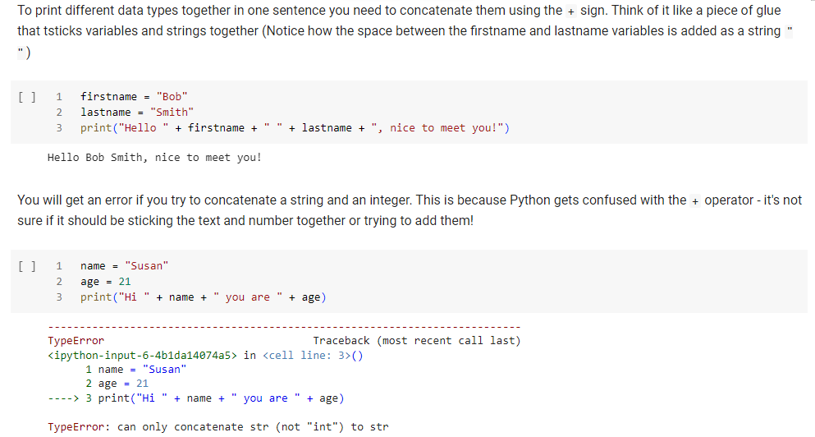
Concatenation (using + on strings)

Slide 6
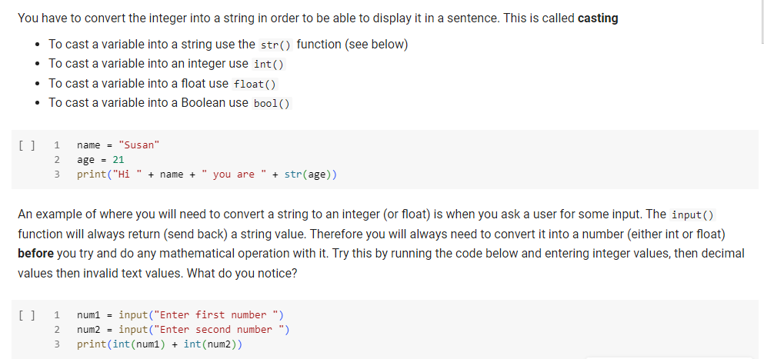
Casting (changing a data type to another)

Slide 7
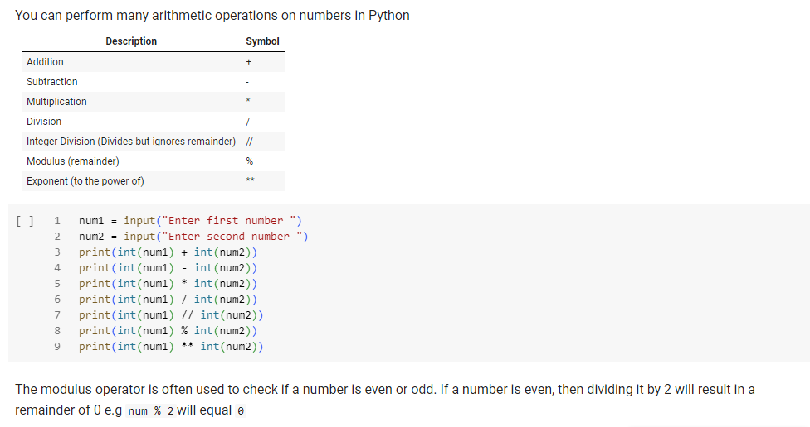
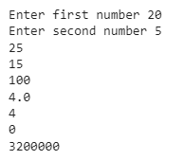
Arithmetic operators

Slide 8
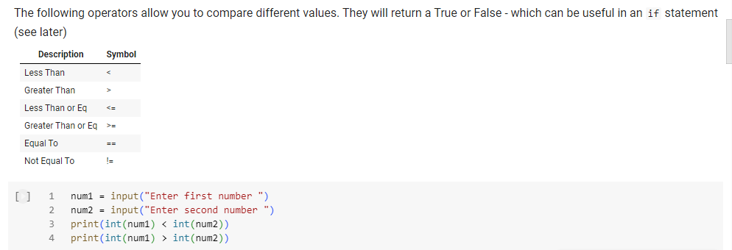

Comparison operators

Slide 9
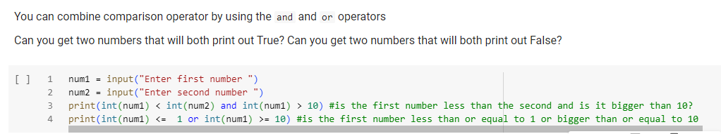

Boolean Operators (and / or)

Slide 10
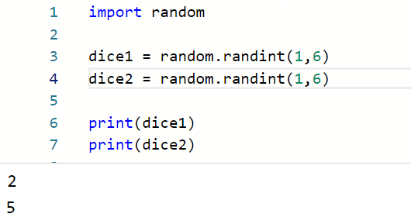
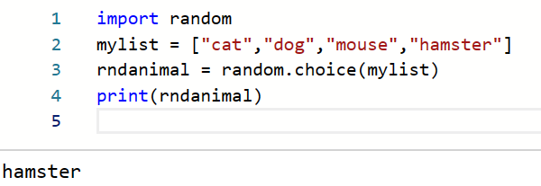
Random Numbers
At the top of the program import the random library
Use random.randint() to generate a random number between two given numbers (inclusive)
You can also use random.choice(list) to get a random item from a list

Slide 11
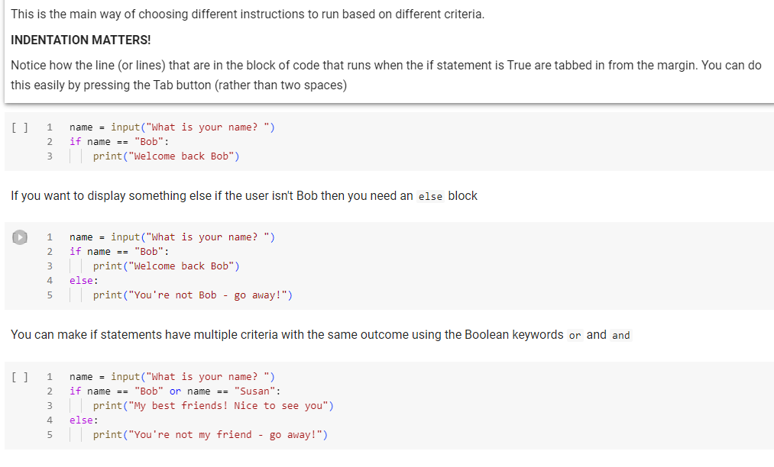
If statements
If the name entered is “John” it wouldn’t print anything

Slide 12
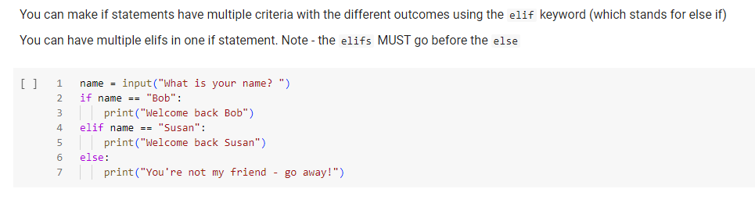
If statements continued

Slide 13
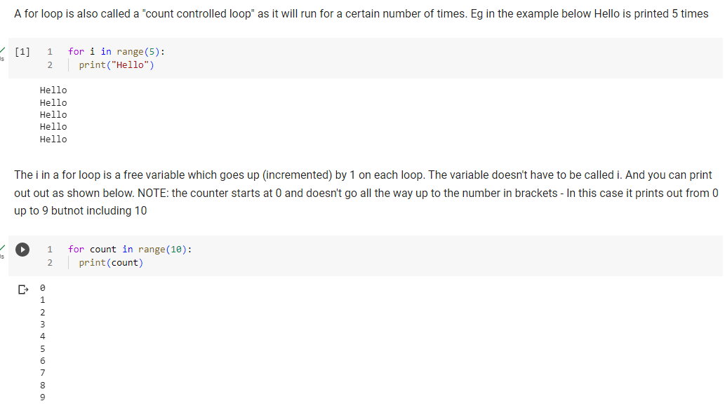
For loops
Indentation matters!

Slide 14
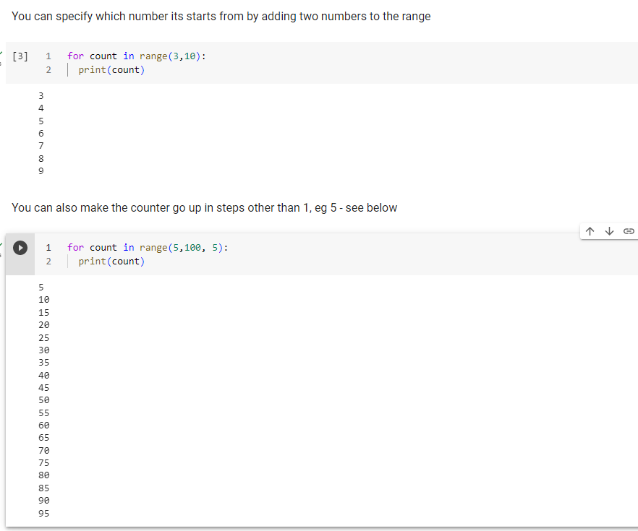
For loops continued
Indentation matters!
Indentation matters!

Slide 15
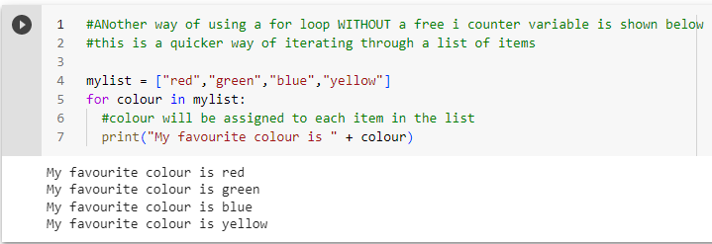
For loops without a free i variable!
Indentation matters!

Slide 16
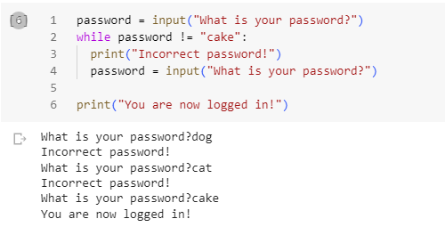
While loops (condition controlled)
Warning: if you don’t ask again inside the loop you may get an infinite loop!
Could loop forever if the user never enters “cake”!
Indentation matters!

Slide 17
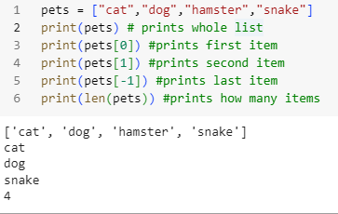
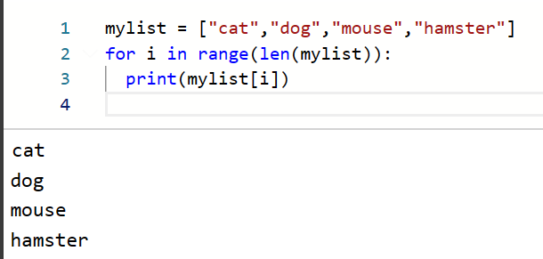

Arrays / Lists (use square brackets)
Storing multiple values in the same variable
(these pair nicely with for loops)
Commas go OUTSIDE of quotes!
len(array) can be used in for loops to loop through an array

Slide 18
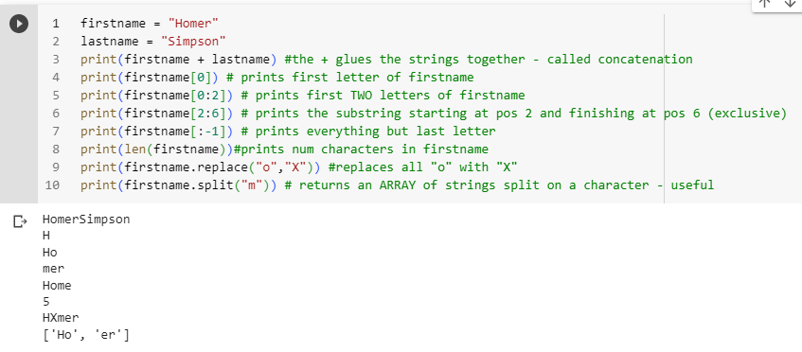
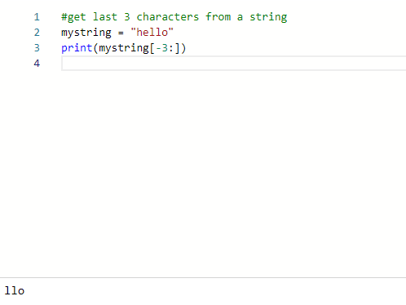
Working with Strings
These are tricky to remember – you can just work with individual letters and then + them together!
A string is basically an array of letters/characters
password[i].isupper() will return True if the character is uppercase
(also islower())
if "X" in emailaddress:
print("there is an X in the email address")

Slide 19
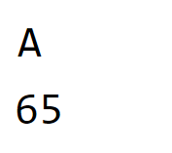
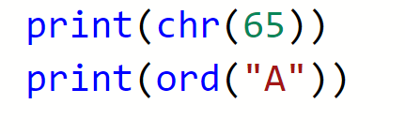
Getting ASCII Values for letters and vice versa using chr() and ord()

Slide 20
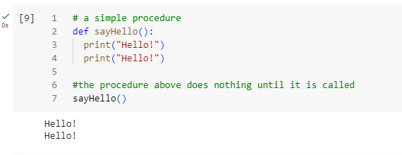
Subroutines (use def to create one)
A subroutine is a named block of code that can be called many times.
Useful because:
It avoids repeating the same code in a program
the name of the subroutine can also help others understand what your code is doing

Slide 21
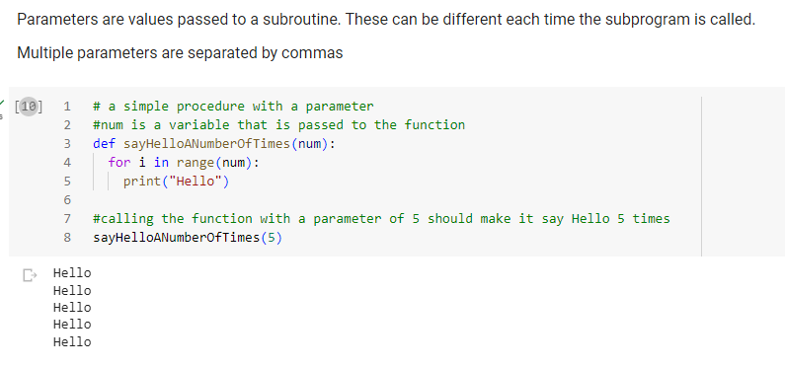
Passing Parameters into a subroutine

Slide 22
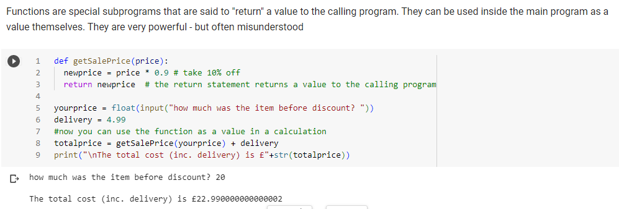
Functions

Slide 23
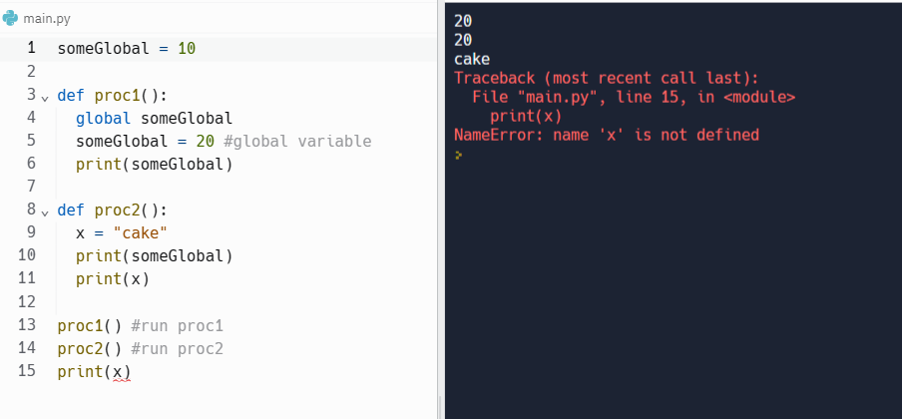
Global variables
Variables declared inside functions are local - they only exist while the function is running then they are discarded
In order to use a variable between functions it must be declared as global
In the small example below someGlobal is created outside the functions but in order for the first function to use it, you have to use the instruction global someGlobal to indicate it is a global variable that can be used in all functions and it will retain its value
X is not global so causes an error

Slide 24
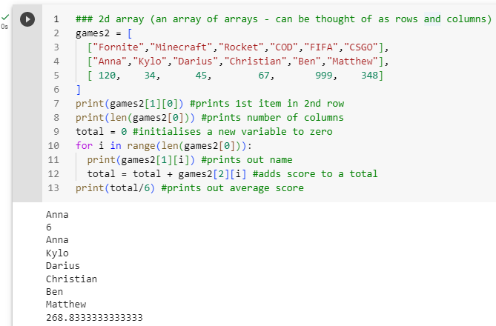
Two Dimensional Arrays

Slide 25
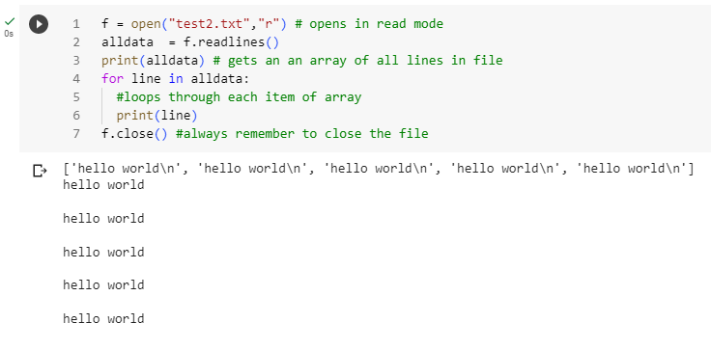
Reading from files

Slide 26
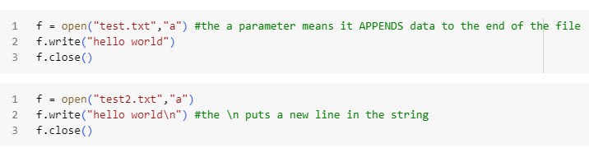
Writing to files
You can also use “w” to overwrite everything in the file

Slide 27
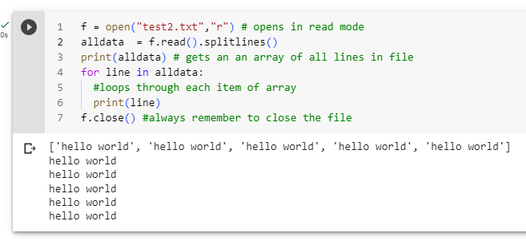
Reading from files – using splitlines() removes all the /n’s!

Slide 28
A Level Tips
Particularly for the onscreen exam.
Not including OOP documentation
OOP Python notebook can be found here:
More A Level Tips / Examples on https://www.pythonsponge.com/pages.html?book=.%2Ftutorial2.json

Slide 29
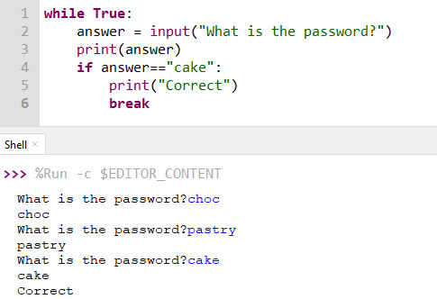

break will stop a loop

Slide 30
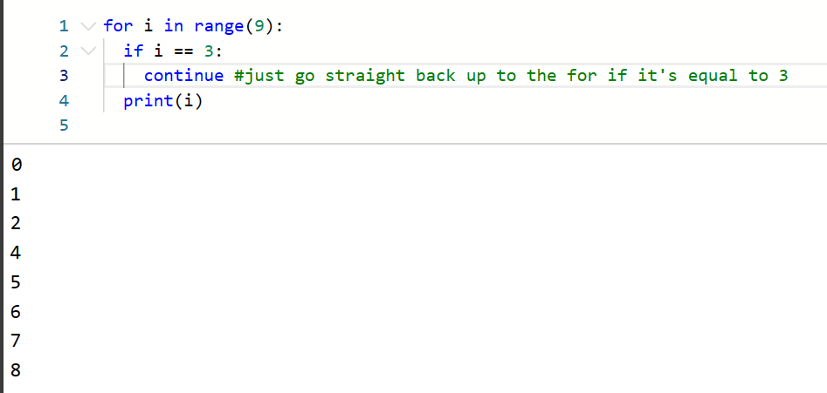

continue will just stop that iteration (and go back to the for/while line)

Slide 31
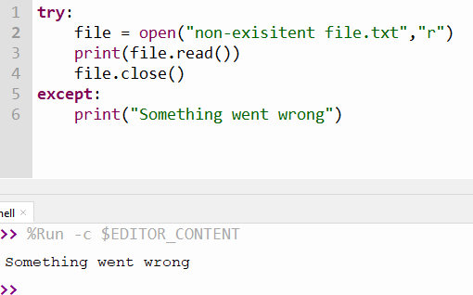
try and except
A quick way to check for errors
Code in the try block will stop as soon as it encounters an error
and go to the except block
(More advanced: you can raise different exceptions but this is beyond A level)

Slide 32
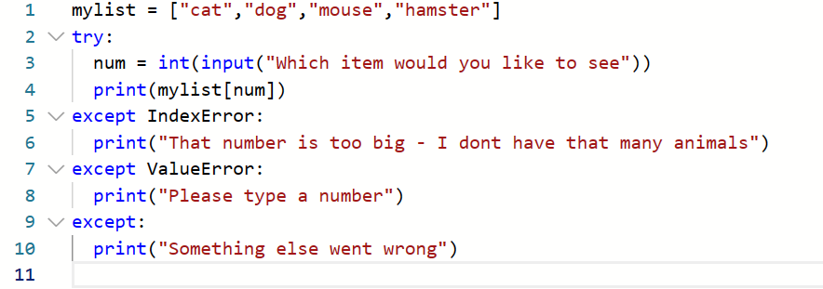
An example showing different error types
How could you keep looping this if they kept getting it wrong?

Slide 33
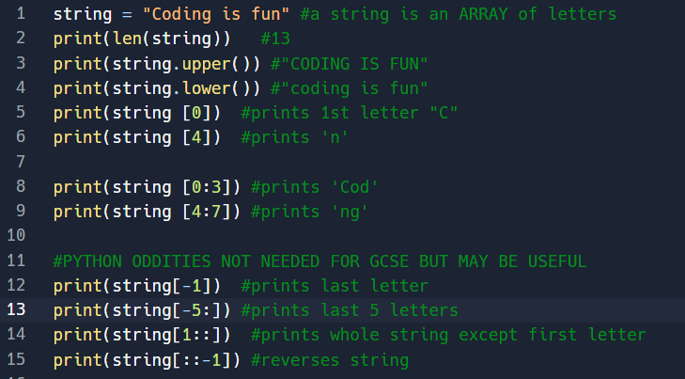
String manipulation useful stuff
https://replit.com/@laurajamesBCS/Y10-A-Playing-with-strings#main.py

Slide 34
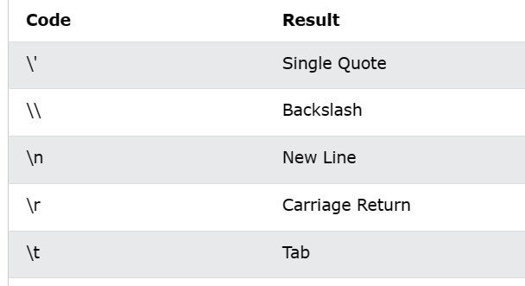
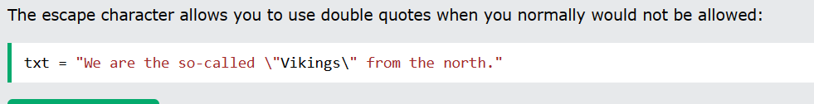
Printing strings
print("hello\nhello")
will print hello followed by hello on next line
If you don't want a newline automatically at the end of your print use:
print("Hello there!", end = "")
Other escape characters

Slide 35
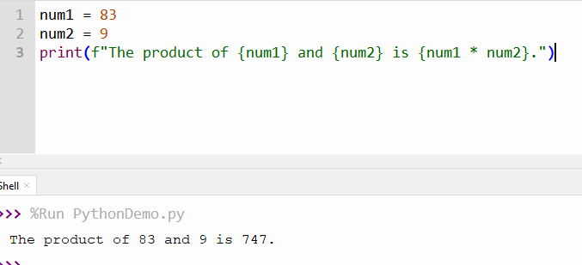
Python f strings
Put an f before the first quotation mark and curly brackets around each variable
Some programmers love this!
Allows you to combine variables with text without worrying about casting

Slide 36
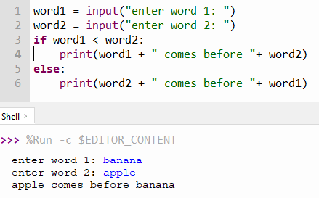
You can use < and > on words & characters

Slide 37
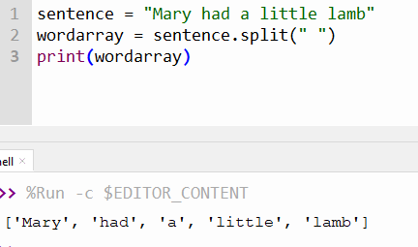
split() to create a list from a string
This will split on spaces – you can use different characters

Slide 38
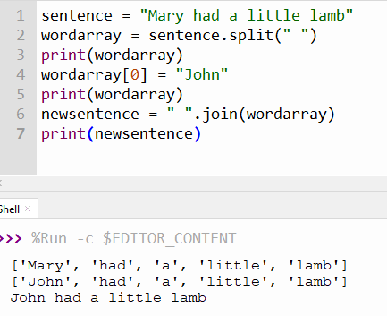
Use join to stick a list back together
The string before the join() function is what you want the separator to be
If you don't want spaces between the list items just put ""

Slide 39
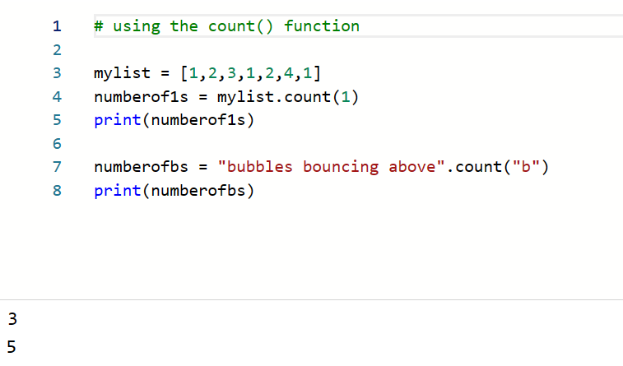
Using the count() function to count number of items in list (or string)

Slide 40
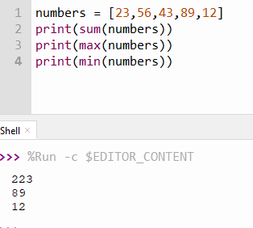
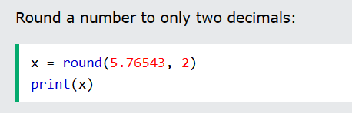
Numbers
Useful functions
sum()
max()
min()
round()

Slide 41
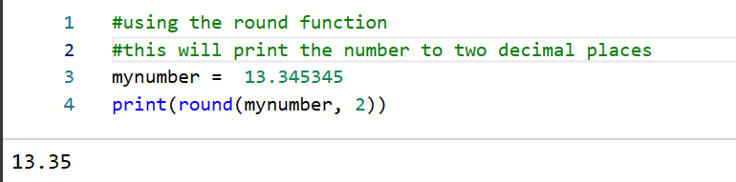
Using the round() function to round a number to a number of decimal places
To simply truncate the number (ie remove the decimals) you can just use int()

Slide 42
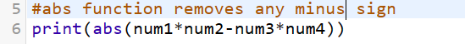
Abs() function (absolute)

Slide 43
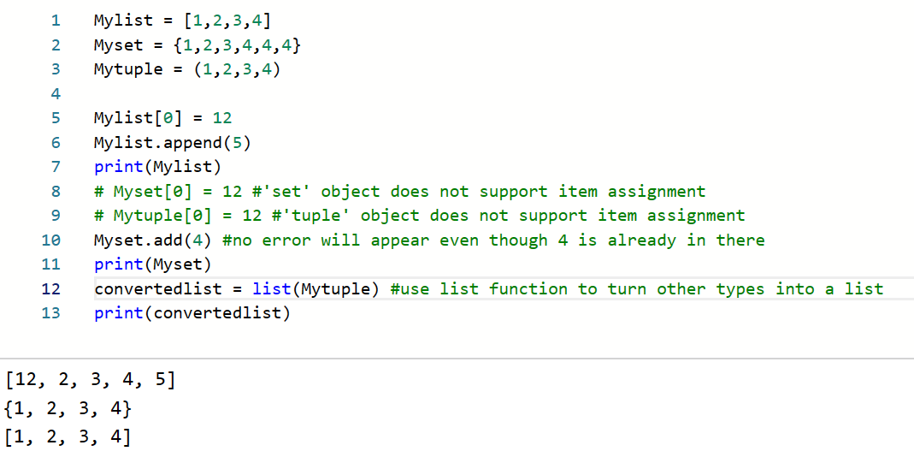
Lists vs Sets vs Tuples
Table of Differences between List, Set, and Tuple
List | Set | Tuple
Lists is Mutable | Set is Mutable | Tuple is Immutable
It is Ordered collection of items | It is Unordered collection of items | It is Ordered collection of items
Items in list can be replaced or changed | Items in set cannot be changed or replaced | Items in tuple cannot be changed or replaced
Mylist = [1,2,3,4] | Myset = {1,2,3,4} | Mytuple = (1,2,3,4)
Allows duplicates | Duplicates not allowed | Allows duplicates

Slide 44
Working with lists(arrays)
Remember a string is a sequence of characters!
However it's immutable – so turn it into a list first using list() – do any operations on it – then turn back to a string using join()
Python has a set of built-in methods that you can use on lists/arrays. Bold ones are the most useful
Method | Description
append() | Adds an element at the end of the list
clear() | Removes all the elements from the list
copy() | Returns a copy of the list
count() | Returns the number of elements with the specified value
extend() | Add the elements of a list (or any iterable), to the end of the current list
index() | Returns the index of the first element with the specified value
insert() | Adds an element at the specified position
pop() | Removes the element at the specified position
remove() | Removes the first item with the specified value
reverse() | Reverses the order of the list
sort() | Sorts the list

Slide 45
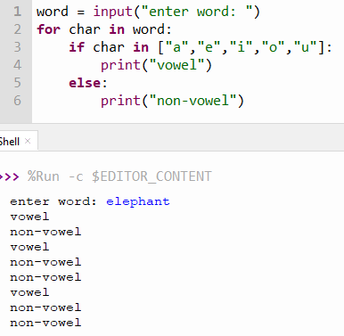
Check if something is in a list
Use the in keyword

Slide 46
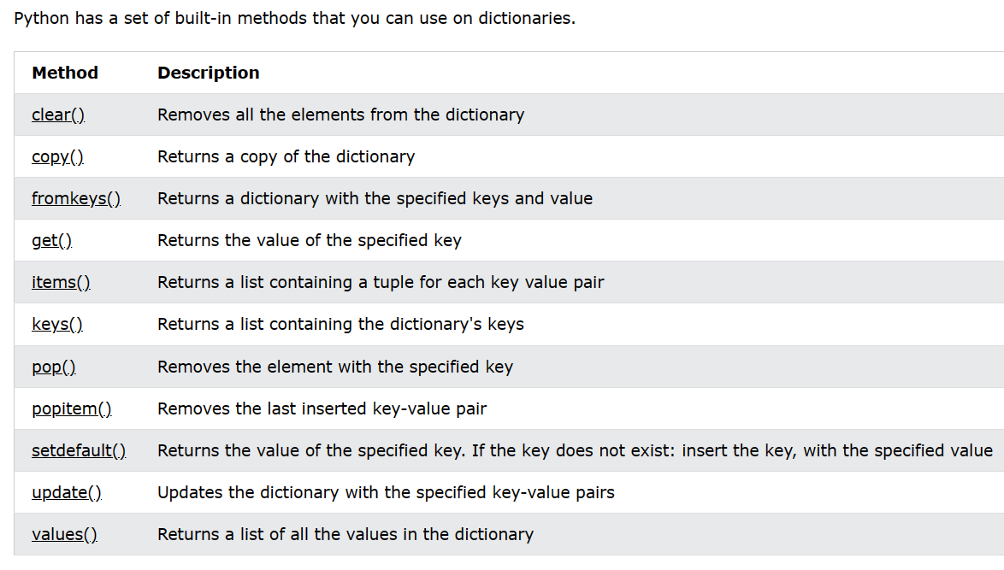
Dictionaries
A dictionary is a collection which is unordered, changeable and indexed. In Python dictionaries are written with curly brackets, and they have keys and values.
Example
Create and print a dictionary:
thisdict = { "brand": "Ford", "model": "Mustang", "year": 1964 } print(thisdict)

Slide 47
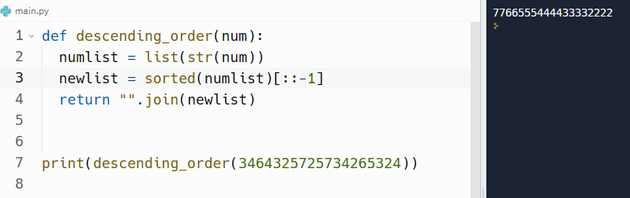
Sorting a list quickly using the sorted() function
newlist = sorted(numlist)
This example takes a long string of digits, splits it into a list of characters (which will sort the same way as the numbers). It then uses the sorted function and then the string slicking method [::-1] to reverse the list
You don't have to write your own sort function in the exam!

Slide 48

Sets
Sets are like lists but have curly brackets {}
Most of the functions you can use with lists you can also do with sets (eg len() append())
They are immutable so you can't change items within the set

Slide 49

Enumerate() (quite niche – but maybe useful?)
Takes a list a creates another list but with pairs of numbered items

Slide 50

Tuple unpacking – initialising multiple variables at once (quite niche – but maybe useful?)

Slide 51

use type() to check what something is
Can be useful if you want to check the class of something.
Useful say of there are different types of Cards in a Deck – might be a good way of working out what type of object something is
See how it can be used in an selection (if) statement

Slide 52

Getting file and directory names
Use os module

Slide 53

Loop through files in directory

Slide 54


Using the collections module to count occurrences of item in a list (cheating?)
Although you can just use the count() function for this (see prev slide)

