Slide 1

Using Flask to create websites with Python
https://flask.palletsprojects.com/en/2.0.x/
https://replit.com/@laurajamesBCS/Y12-Flask#main.py

Slide 2
Lesson 1

Slide 3
Add this to the top of your Repl
from flask import Flask
OR
from flask import Flask, render_template, request, flash, redirect

Slide 4
Create the website object
web_site = Flask(__name__)

Slide 5
The home page
These are called "decorators"
You need a line for each of the urls you plan to use in your site.
Immediately after the route you need to include a function. This will run when a user accesses your page.
You must supply a return value
@web_site.route('/')
def index():
  print("Hello World")
  return "Hello world!"
This line prints "hello world" to the console
This line takes the user to a web page that says "Hello World!"

Slide 6
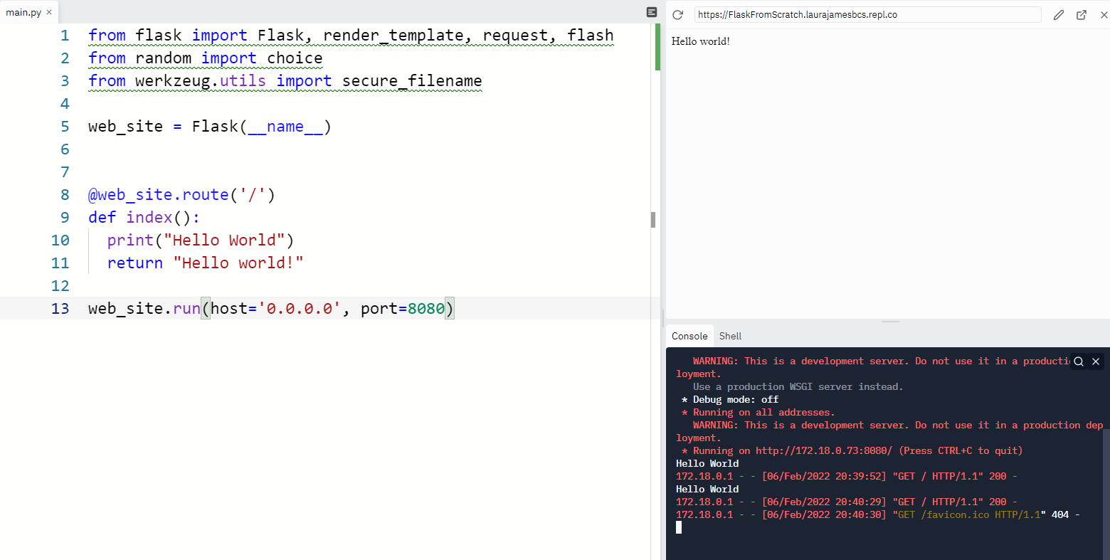
The last line – don't forget this!
Add this line to the end to tell REPL to run your website
web_site.run(host='0.0.0.0', port=8080)
Your amazing web page
Notes:
from flask import Flask, render_template, request, flash
from random import choice
from werkzeug.utils import secure_filename
web_site = Flask(__name__)
@web_site.route('/')
def index():
print("Hello World")
return "Hello world!"
web_site.run(host='0.0.0.0', port=8080)

Slide 7
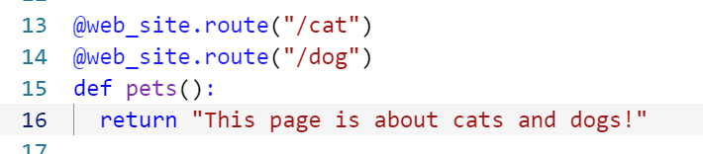
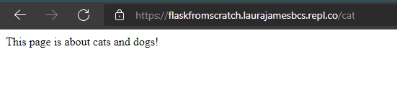
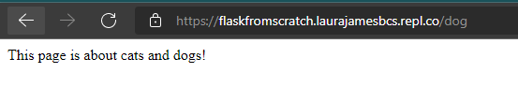
Adding more pages
You can have multiple routes that do the same thing
To test this, view your Flask site in a new window and add "/cat" and "/dog" to the end of the url to show it shows the same message for each.
Don't forget to press Run first!

Slide 8
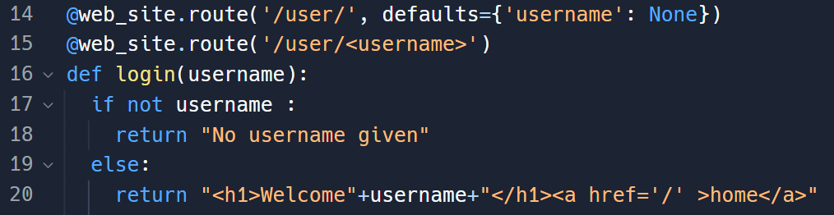
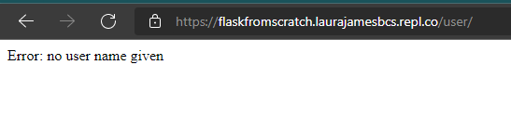

Getting data from the url
Notes:
@web_site.route('/user/', defaults={'username': None})
@web_site.route('/user/<username>')
def welcome_user(username):
if not username:
username = request.args.get('username')
if not username:
return 'Error: no user name given'
return "welcome back "+ username

Slide 9
Lesson 2

Slide 10
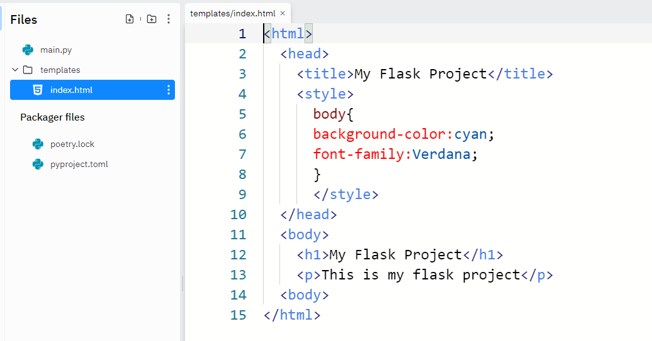
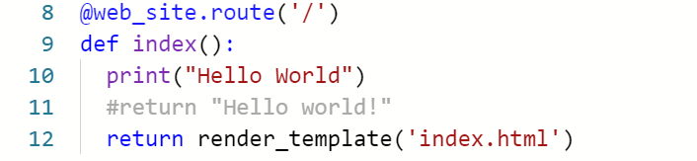
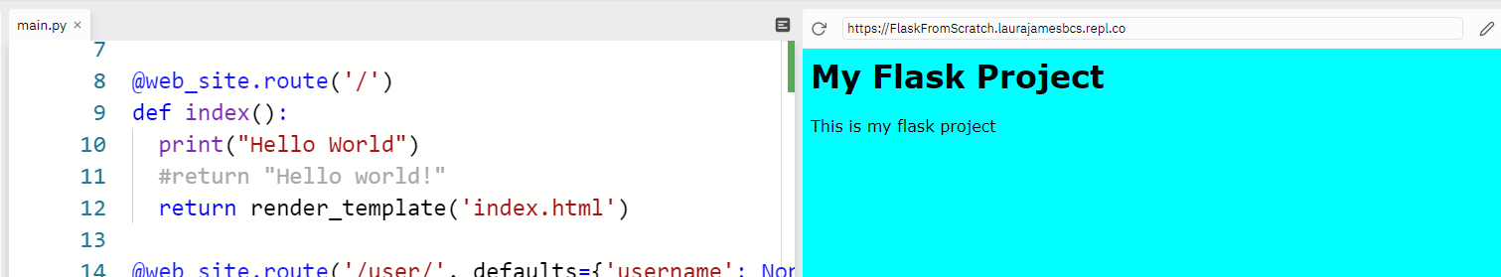
Using HTML in a Flask project
HTML gives greater freedom to create appealing user interfaces
Create a folder called templates and store the html files in there
Then render the templates instead of returning plain text in each function
result

Slide 11
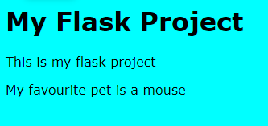
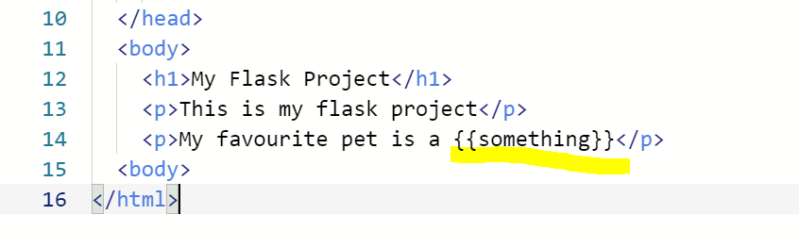
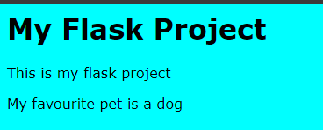
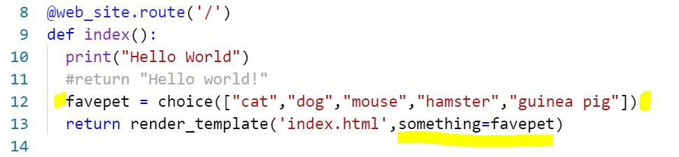
Creating flexible templates
https://flask.palletsprojects.com/en/2.0.x/tutorial/templates/
You can mark out blocks on your HTML templates to display dynamic content. Then fill them in with Python
You can pass multiple items and different data types this way

Slide 12
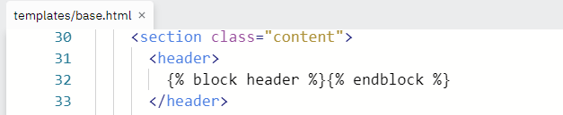
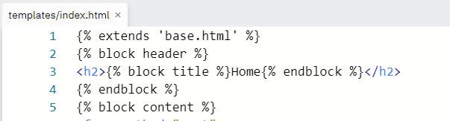
Using block templates
To efficiently create similar pages for a web site you can use block templates.
This means you can have common headers and footers while certain elements of the page change when on different urls

Slide 13
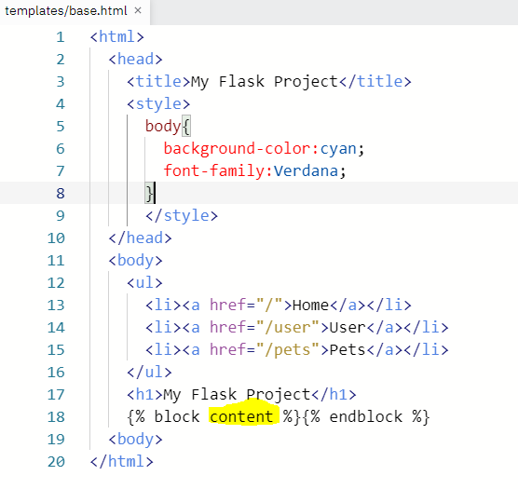
Create a base.html file
This should be the "outer" html file and include all the shared elements
Mark out areas that can be customised by other pages
This block is called content
Notes:
ul{
display: flex;
}
ul > li {
flex: 1;
list-style:none;
}

Slide 14
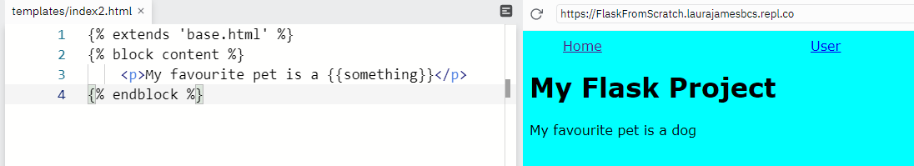
Your template files can now inherit this base.html file
At the top of each html file you can use
{% extends 'base.html' %}
Then declare what should go in each of the named blocks using
{% block content %}
And ending with
{% endblock %}

Slide 15
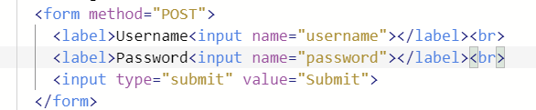

Getting data from users on the page
A new tag <form>
All the inputs inside the <form> tag will be submitted
Inputs can be many different types – usually "text" or "submit"
  Can be password, date, hidden, range but beyond scope of this ppt!
The key attribute to remember is the name as that is what it is referred to when it gets sent back to the server

Slide 16
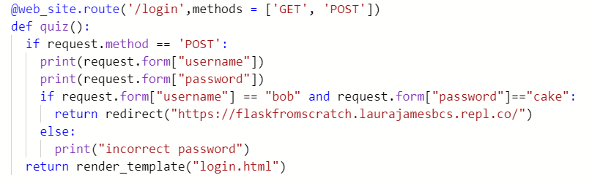
Using these fields in Python
Need to detect if the form has been submitted
  Two methods available – GET and POST
The code below checks the name and password and redirects if correct

Slide 17
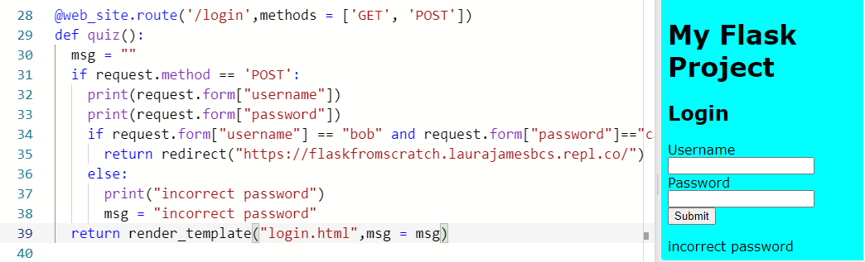
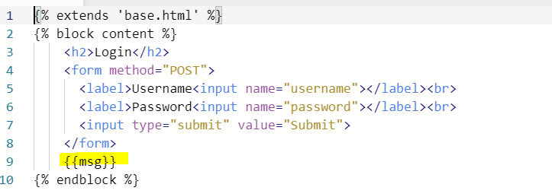


Passing a parameter to write a message back to the page

Slide 18
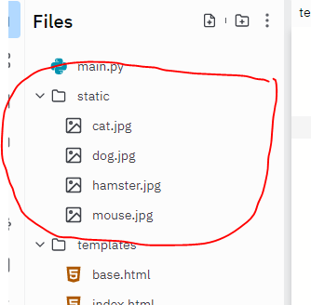
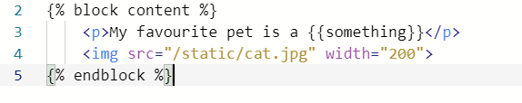
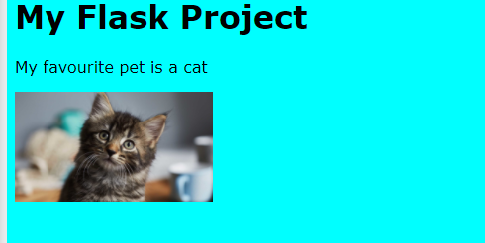
Showing images
Lesson 3:
Create a folder named "static" and place images and other static files there
To show an image you can use the HTML tag <img>

Slide 19
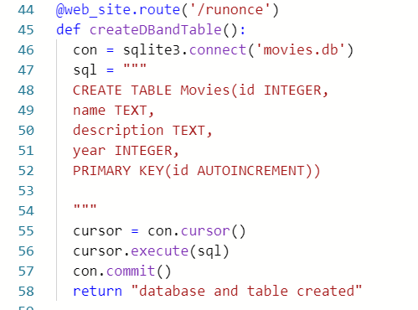
Connecting a Database
Don't forget to
import sqlite3
At the top!
Need to create the table first using a CREATE TABLE SQL statement (technically this is called DDL – Data Definition Language)
Only need to create it once! (errors if you try to create it again)
Import sqlite at the top of the code
This code will create a database
And create a table called Movies
https://replit.com/@laurajamesBCS/FlaskFromScratch#static/script.js
http://kesdigital.uk/pythonapp
Notes:
https://gist.github.com/laura-james/fe2d19546175574009a1eabc58e68554
@web_site.route('/runonce')
def createDBandTable():
con = sqlite3.connect('movies.db')
sql = """
CREATE TABLE Movies(id INTEGER,
name TEXT,
description TEXT,
year INTEGER,
PRIMARY KEY(id AUTOINCREMENT))
"""
cursor = con.cursor()
cursor.execute(sql)
con.commit()
return "database and table created"

Slide 20
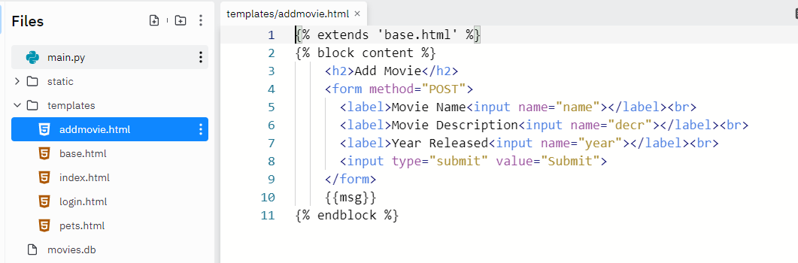
Inserting data into table (part 1)
Two methods to get data from a user to add to the database:
Take input from the url (query string arguments)
Or use form inputs << We will do this
We need to build a form to collect the data before we add it to the database
Notes:
https://gist.github.com/laura-james/22a82acd494c50deb583e911a5a26fca
{% extends 'base.html' %}
{% block content %}
<h2>Add Movie</h2>
<form method="POST">
<label>Movie Name<input name="name"></label><br>
<label>Movie Description<input name="descr"></label><br>
<label>Year Released<input name="year"></label><br>
<input type="submit" value="Submit">
</form>
<strong>{{msg}}</strong>
{% endblock %}

Slide 21
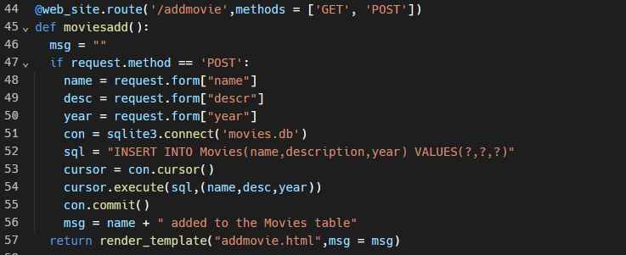
Code for adding a record to the table
The ? Marks are parameterised values - to prevent SQL injection

Slide 22
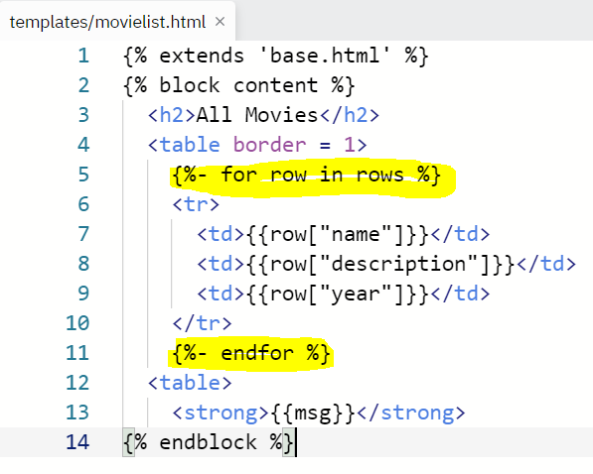
Displaying a list of records from a database (part 1)
In this template we are using a "For loop" to iterate over a list object rows (which we get from a SQL SELECT query)
Notice as well the <table> tags which denote the start and end of a table
The <tr> tags denote the start and end of table rows
The <td> tags denote table cells
Notes:
https://gist.github.com/laura-james/3455ee81cc6cfe54b2268d855ac89b32
{% extends 'base.html' %}
{% block content %}
<h2>All Movies</h2>
<table border = 1>
{%- for row in rows %}
<tr>
<td>{{row["name"]}}</td>
<td>{{row["description"]}}</td>
<td>{{row["year"]}}</td>
</tr>
{%- endfor %}
</table>
{% endblock %}

Slide 23
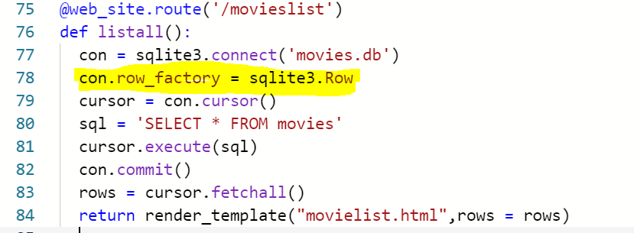
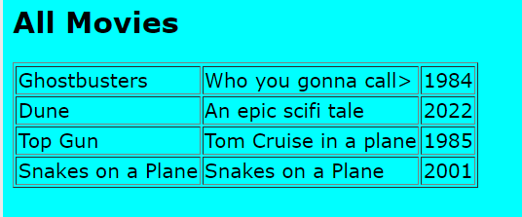
Displaying a list of records from a database (part 2)
Lesson 4:
The route definition sets up a connection to the database.
The addition of the highlighted row allows Python to access the field names when getting the data rather than relying on the numerical indexes (eg row["name"] rather than row[0])
Norice how the render_template method is passing the rows variable to the template (which was being iterated over in the previous slide)
Notes:
https://gist.github.com/laura-james/8c4085383f80811a0c9a7eadb0a7c57c
@web_site.route('/movieslist')
def listall():
con = sqlite3.connect('movies.db')
con.row_factory = sqlite3.Row
cursor = con.cursor()
sql = 'SELECT * FROM movies'
cursor.execute(sql)
con.commit()
rows = cursor.fetchall()
return render_template("movielist.html",rows = rows)

Slide 24
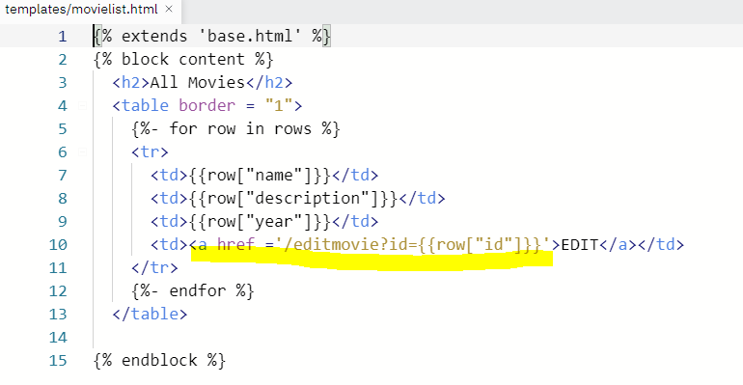
Adding a link to edit/delete a record (part 1 of 2)
Step 1:
Modify the movielist.html template to include a link that sends the id as a parameter to a new url (editmovie?id=1)
Notes:
https://gist.github.com/laura-james/a1afd2657a7fab9540c9c2e67d9a971f
{% extends 'base.html' %}
{% block content %}
<h2>Add Movie</h2>
<form method="POST">
<label>Movie Name<input name="name" value={{}}></label><br>
<label>Movie Description<input name="descr"></label><br>
<label>Year Released<input name="year"></label><br>
<input type="submit" value="Submit">
</form>
<strong>{{msg}}</strong>
{% endblock %}

Slide 25
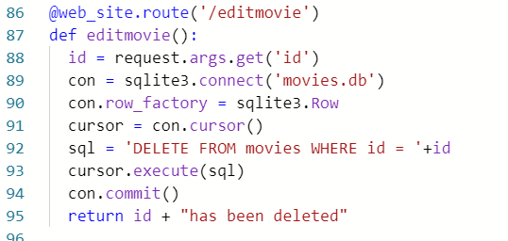
Adding a link to edit/delete a record (part 2 of 2)
Step 2:
Add a new route to get that id and use it to DELETE the record
Notes:
https://gist.github.com/laura-james/21a649b7fc21ca6d14c055eba31c9873
@web_site.route('/editmovie')
def editmovie():
id = request.args.get('id')
con = sqlite3.connect('movies.db')
con.row_factory = sqlite3.Row
cursor = con.cursor()
sql = 'DELETE FROM movies WHERE id = '+id
cursor.execute(sql)
con.commit()
return id + "has been deleted"

Slide 26
What now?
Useful tutorial on Replit...
https://docs.replit.com/tutorials/28-technical-challenge-site
https://replit.com/@laurajamesBCS/FlaskFromScratch#main.py <<<Mrs James WIP site (work in progress)

Slide 27
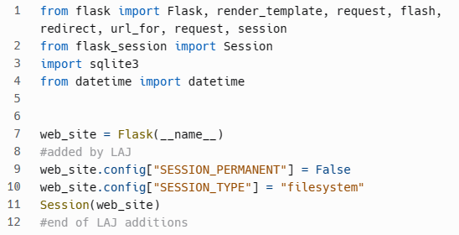
Sessions – how to remember stuff between pages
Sessions are the way to go to remember stuff between pages. In the old days people used cookies (and still do if they want to track you between websites) but as you only want to remember people between pages then session variables are the thing to use.
Basically a session is a sort of array or dictionary of values that you can get/set in your applications and it's stored on the server (it's a bit like a mini database but much easier to use and it's meant for this kind of thing)
this was a good tutorial: https://www.geeksforgeeks.org/how-to-use-flask-session-in-python-flask/

Slide 28
Sessions continued – setting a session var
if password == getpassword:
session["name"] = username # LAJ this is when the session var gets stored
print("setting session.....") #LAJ
return redirect(url_for('listmyposts', id=username))

Slide 29
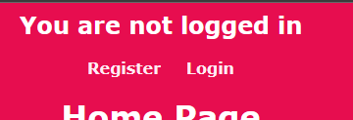
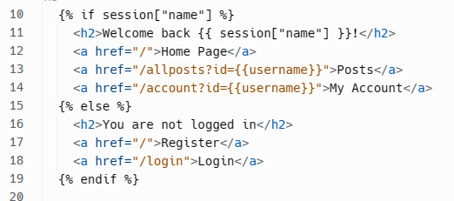
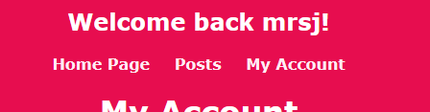
Sessions (con) – reading a session variable

Slide 30
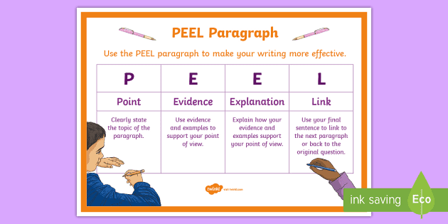

Slide 31
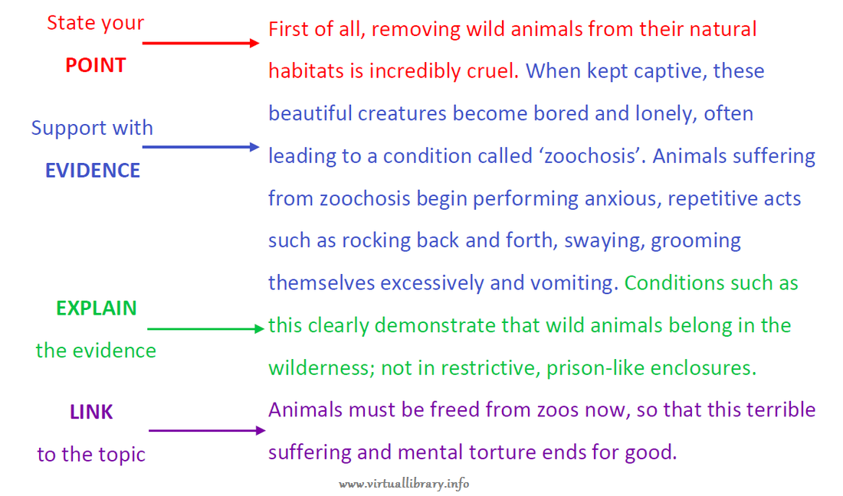

Slide 32
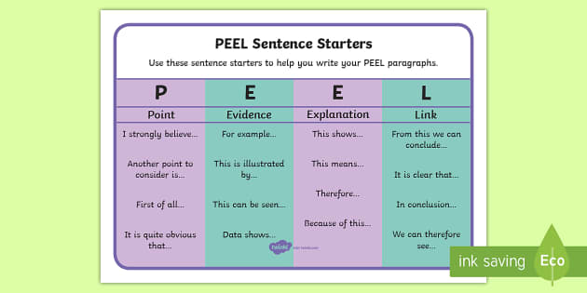

Slide 33
