Slide 1
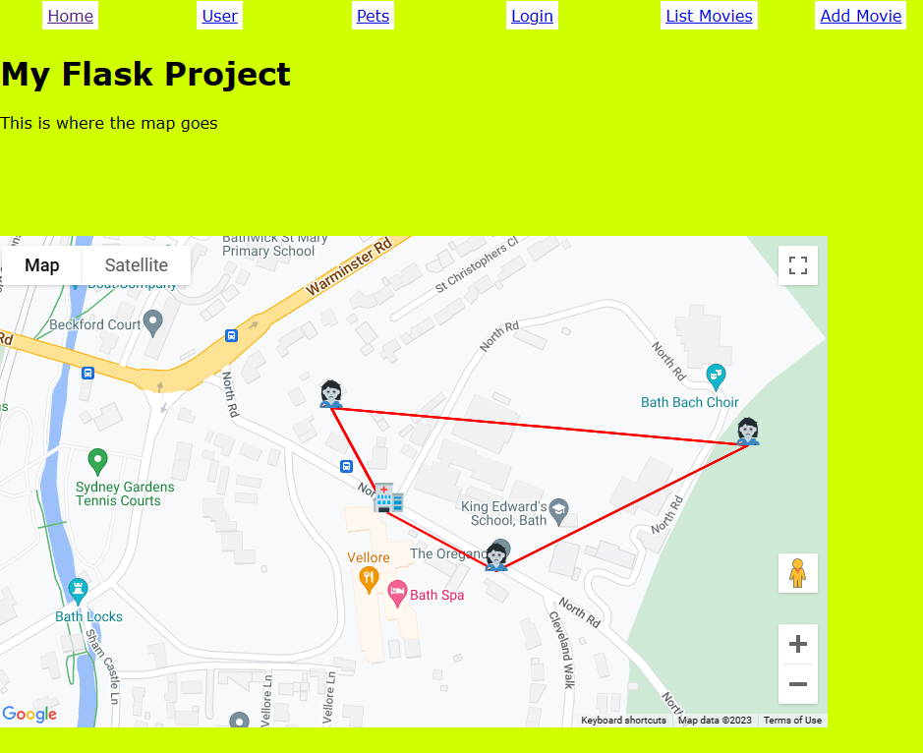
Using Google Maps In Flask
https://flaskfromscratch.laurajamesbcs.repl.co/map

Slide 2
a lot of this code is from here https://projects.raspberrypi.org/en/projects/wheres-zombie
(We tried this in Year 9)
You'll need to sign up for a Google Maps API Key (and perhaps give them your cc details…)
https://console.cloud.google.com/projectselector2/

Slide 3
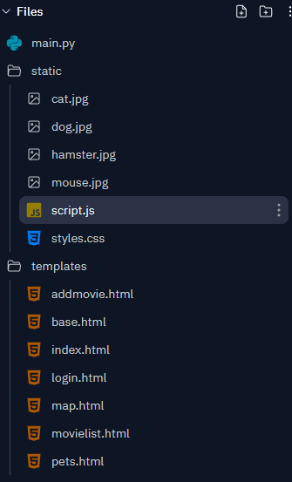
In Flask make sure you have these new files
Most of the code goes here
Add a few rules to style the map area
New template to hold map page
New function to handle a map page request

Slide 4
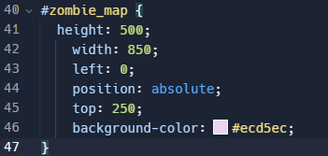
CSS – determine size and position of map

Slide 5
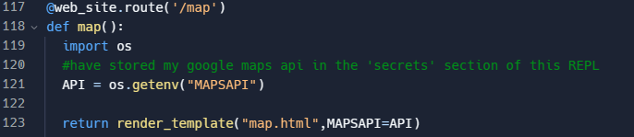
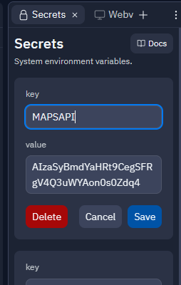
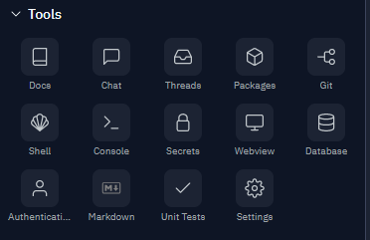
Edit main.py and add new function
Recommend storing your Google Maps API in the Secrets section of REPL to protect it

Slide 6
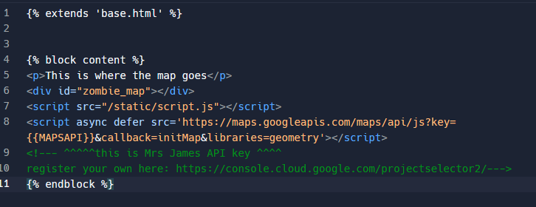
map.html (template)
Same as other templates –just reading the MAPSAPI variable from Python

Slide 7
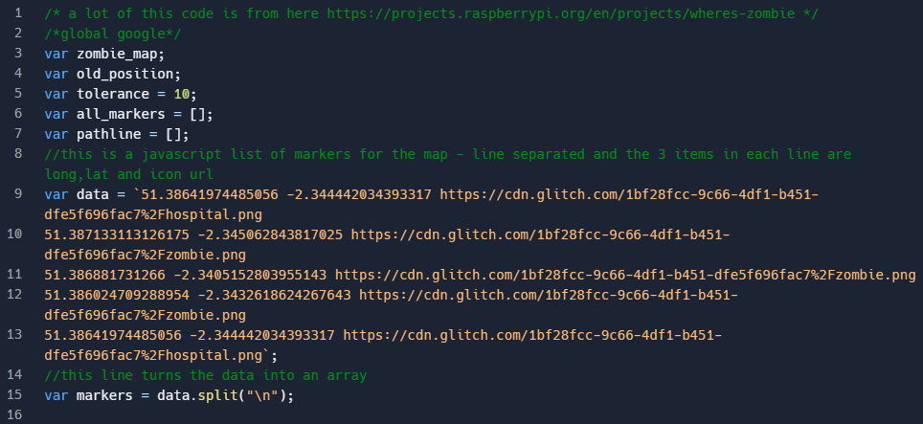
script.js – initialise some vars (path is in the data variable – 5 points)

Slide 8
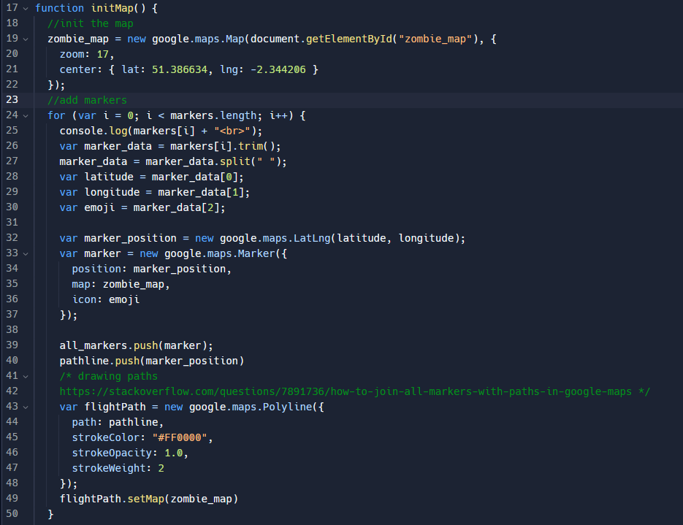
initMap()
Sets up map, adds markers and a path between them

Slide 9
The next two features you may not need

Slide 10
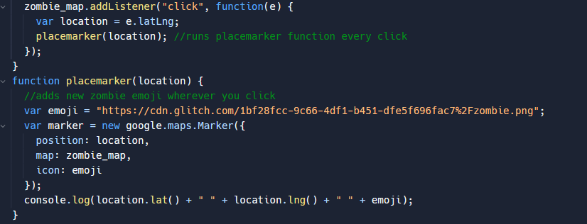
Add new markers (by clicking)

Slide 11
